Slide 1
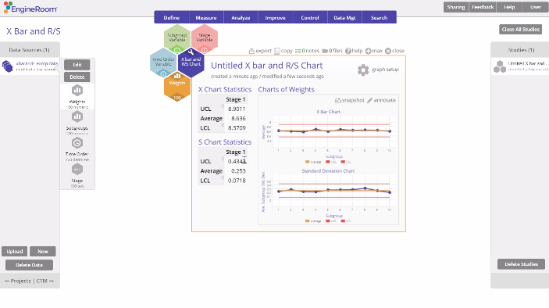
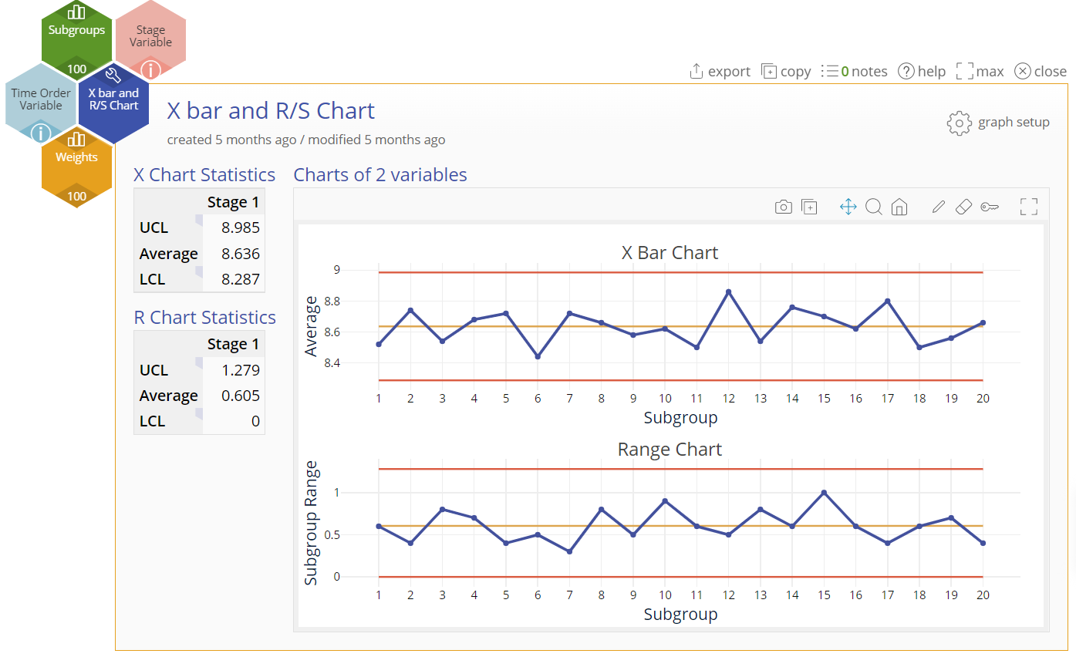
X bar and R/S Chart
When to use this tool
Use the X bar and R/S Chart to monitor and assess the stability of a process when the data consist of subgroups of size 2 or more.
This chart requires numeric data on a continuous process characteristic, such as cycle time, weights, amounts, etc.
The X bar Chart shows how the mean or average of the process changes over time and the R (or S) Chart shows how the range or variance changes over time.
X bar and R Charts are recommended for subgroup sizes of 10 or less. If the subgroup size exceeds 10, the R (range) Chart is replaced by an S (standard deviation) Chart, which plots subgroup standard deviation instead of range.
Tutorial:
https://media.moresteam.com/university/tutorials/nonint/new/XbarRS.mp4

Slide 2
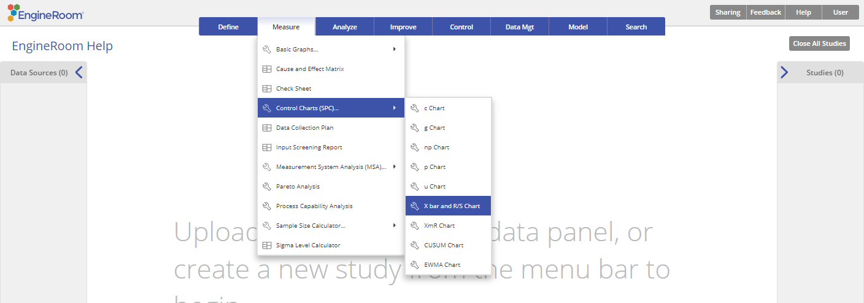
Using EngineRoom
Measure > Control Charts (SPC) > X bar and R/S Chart

Slide 3
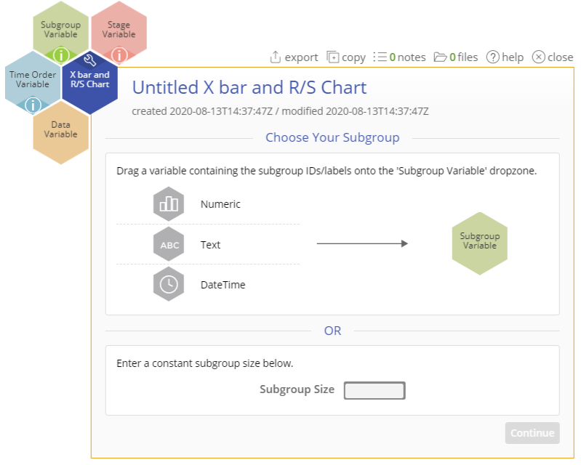
Using EngineRoom
To use the X Bar and R charts, collect data on at least 20 subgroups. The subgroup size can be anything greater than 1, though subgroups of size 5 are most common.
There are four “drop zones” attached to the study:
Data Variable (required): For the measurement data variable. This variable must be numeric.
Subgroup Variable: For the variable containing the subgroup IDs. If subgroup size is constant, you can ignore this drop zone and enter the value in the dialog box. This variable can be numeric or text.
Time Order Variable (optional): Use if you have a variable containing the time stamps of the subgroup measurements. This variable can be numeric or date/time.
Stage Variable (optional): Use if you have a variable identifying different stages (such as “before” and “after” an improvement initiative). This variable can be numeric, text, or date/time.

Slide 4
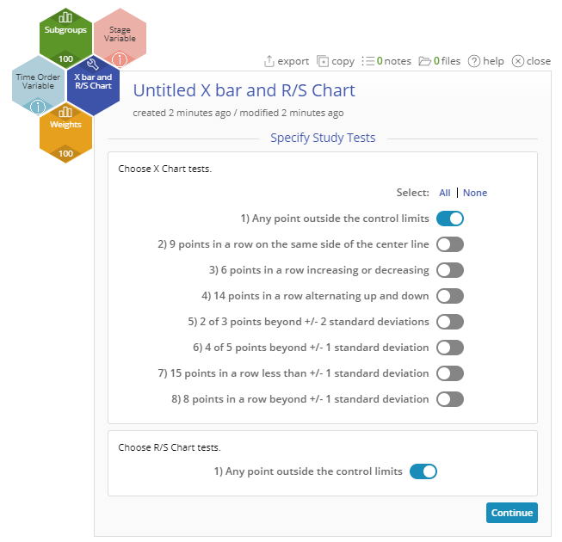
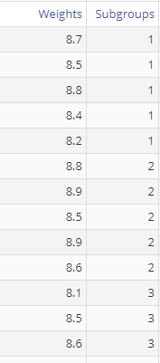
X bar and R/S Chart Example
xbarandr_exmpldata.xlsx
The data set provided contains a column (Weights) containing the numeric measurements and another column (Subgroups) containing the subgroup IDs, representing the 20 subgroups of size 5.
Click on the data file in the data sources panel and drag Weights onto the Data Variable drop zone.
Click and drag Subgroups onto the Subgroup Size drop zone. Alternatively, enter the constant subgroup size “5” in the Subgroup Size box in the dialog box.
Select any run tests you want to use. By default, only the first test (any point outside control limits) is selected.
Click “Continue.”
Select any optional graph settings shown on the second screen.
Click “Continue.”

Slide 5
X bar and R/S Chart Example Output
Notes:
Output Note:
The Xbar and R Chart output includes the Individual (X) control chart, the Range (R) control chart and numeric tables listing the averages, and upper and lower control limits for each chart
To edit the chart, click on the plotted points or lines and select the options for thickness, color, and style.
Select the graph setup button to change the graph settings previously selected.

