Slide 1
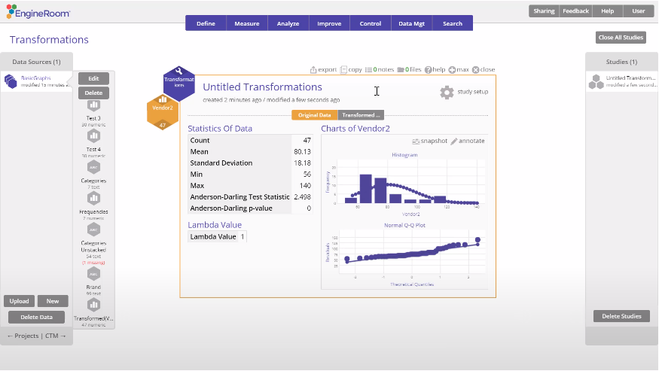
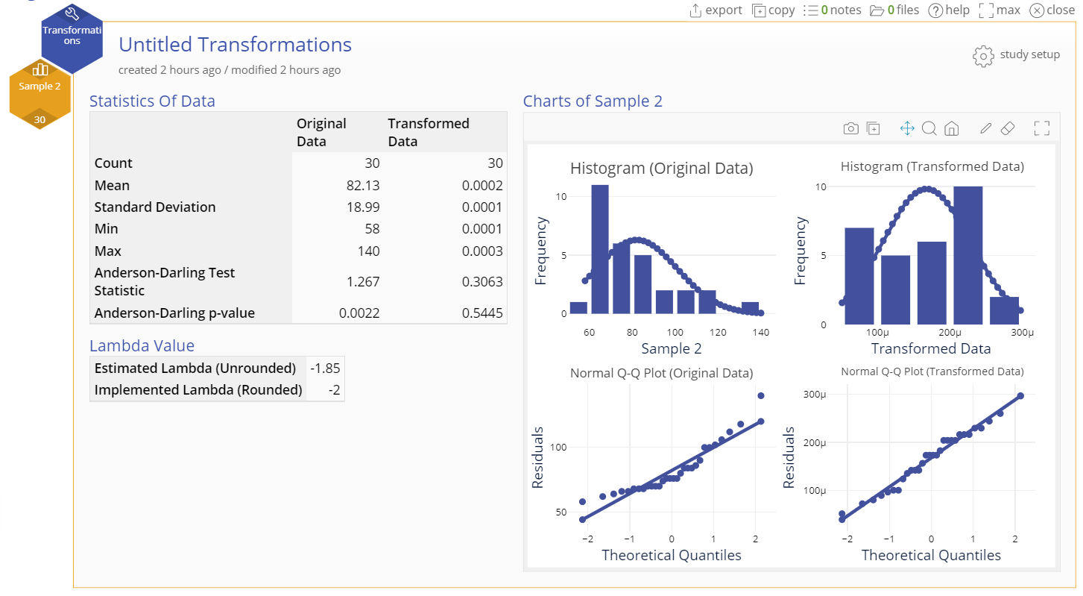
Transformations
When to use this tool
Transformations are mathematical functions that help change the shape or scale of the data to which they're applied. Many parametric tests assume the data are taken from a normal distribution.
If your data don't meet this requirement, one option is to transform the data so they more closely approximate the normal distribution. Now that they meet the test requirement, you can run it.
Note: For a given data set, some transform functions may help meet the requirements and others may not. In some instances, none will. Look at your data after each transform function to see whether the goal of the transformation - to make the data more “normal” - was achieved.
Tutorial:
https://media.moresteam.com/university/tutorials/nonint/new/Transform.mp4

Slide 2
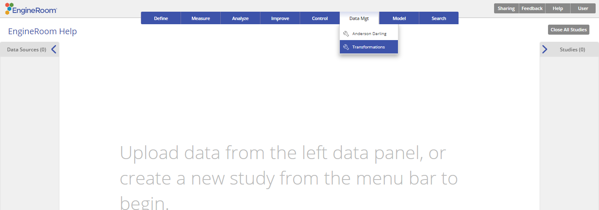
Using EngineRoom
Data Mgt > Transformations

Slide 3
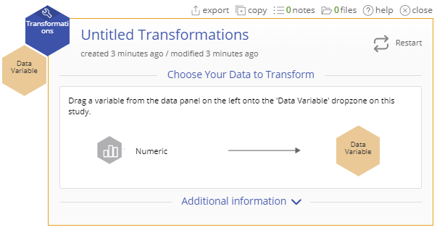
Using EngineRoom
The data set provided in the next slide contains one non-normal variable (Sample 2).
We will apply a transform to that sample so it approximates a normal distribution.
Notes:
Note: Guided mode is ENABLED for the following example

Slide 4
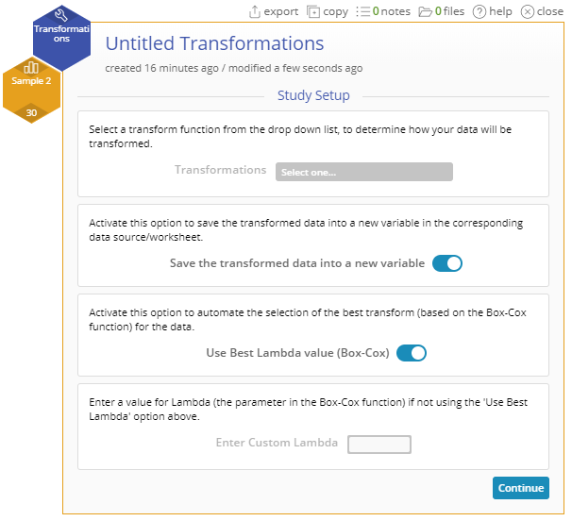
Transformations Example
ADnormality_test_data.xlsx
Click on the data file in the data sources panel and drag Sample 2 onto the Data Variable drop zone.
You now have several options for the choice of transform function:
A) You can select a transform from the dropdown list provided.
Arcsine
Arcsine Square-Root
Inverse
Inverse Square-Root
Logarithm
Natural Logarithm
Square
Square-Root

Slide 5
Transformations Example
(B) Turn on the Use Best Lambda value (Box-Cox) method to find the optimal lambda (power transformation parameter) value that will best approximate the normal distribution.
Note: The transform functions listed in the dropdown menu above are all specific instances of Box-Cox transformations:
Lambda | Transform Function
-1 | Inverse
-½ | Inverse Square-root
0 | Natural Logarithm
½ | Square-root
2 | Square

Slide 6
Transformations Example
(C) You also can enter a specific Lambda value to create your own transformed data. EngineRoom will transform the original variable (Y) using the transform function (Y^Lambda).
Turn on the option Save the transformed data in a new variable in the data source so you can work with the transformed data.
Click “Continue.”

Slide 7
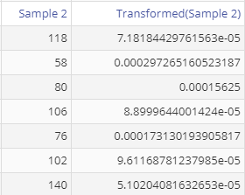
Transformations Output
In this example, the inverse square of the data was found to be the best transform. The transformed variable is stored in the original data source file so you can use it in further analysis:
Notes:
Output Notes:
The study output includes, for both the original and transformed variable:
a histogram with a normal distribution overlaid on the data
a normal probability (QQ) plot
a table of descriptive statistics along with the AD test statistic and p-value.
It also displays the estimated lambda value and a more easily interpreted rounded value that is used to transform the data.

