Slide 1
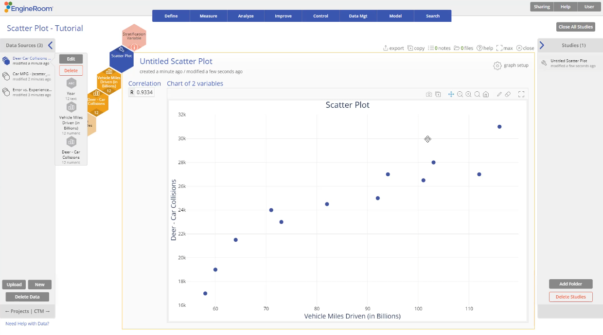
Scatter Plot
When to use this tool
Scatter plots display the association between pairs of numeric variables, showing how changes in one affect the other. They may or may not show patterns between 2 variables. Guidelines for interpreting:
Strong Positive Correlation is indicated by a tight pattern of points with an upward slope
Weak Positive Correlation is indicated by a loose pattern of points with an upward slope
Strong Negative Correlation is indicated by a tight pattern of points with a downward slope
Tutorial:
https://media.moresteam.com/university/tutorials/nonint/new/scatterplot.mp4
Weak Negative Correlation is indicated by a loose pattern of points with a downward slope
No Correlation is indicated by a loose pattern of plots with no appreciable slope
Notes:
Note:
Keep in mind the actual association you see between two variables may fall somewhere in between these examples.
Strong Positive - indicates that an increase in one variable is strongly associated with a linear increase in the other variable - such as the correlation between distance traveled and the amount of fuel used.
Weak Positive - indicates that an increase in one variable is weakly associated with a linear increase in the other variable - such as the correlation between number of hours worked and frequency of errors.
Strong Negative - indicates that an increase in one variable is strongly associated with a linear decrease in the other variable - such as the correlation between the speed of travel and time to reach your destination.
Weak Negative - indicates that an increase in one variable is weakly associated with a linear decrease in the other variable - such as the correlation between sales of ice cream and woolen hats in a particular city for a given month.
No Correlation - indicates that a change in one variable is not necessarily associated with any change in the other variable - such as the association between the number of employees in a company and customer satisfaction scores for its product.

Slide 2
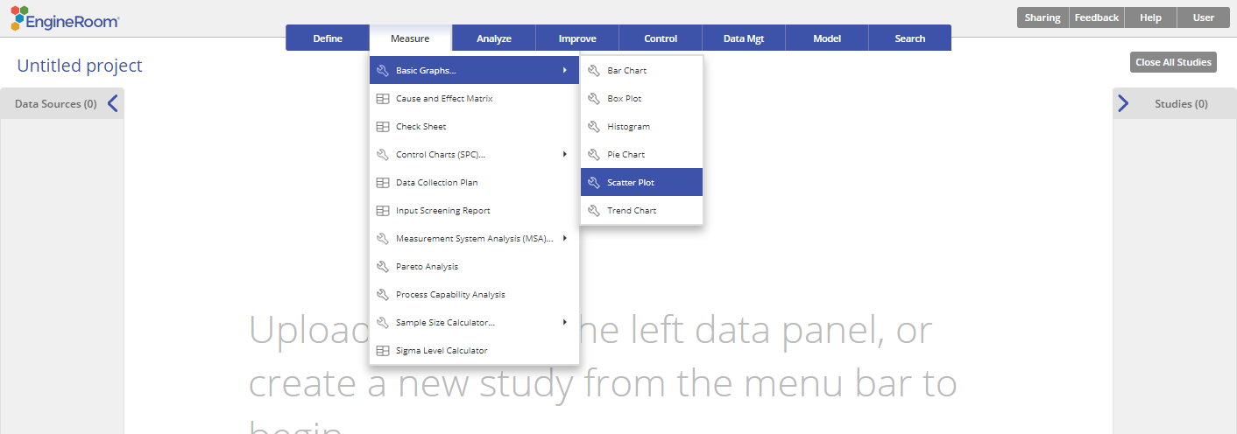
Using EngineRoom
Measure > Basic Graphs > Scatter Plot

Slide 3
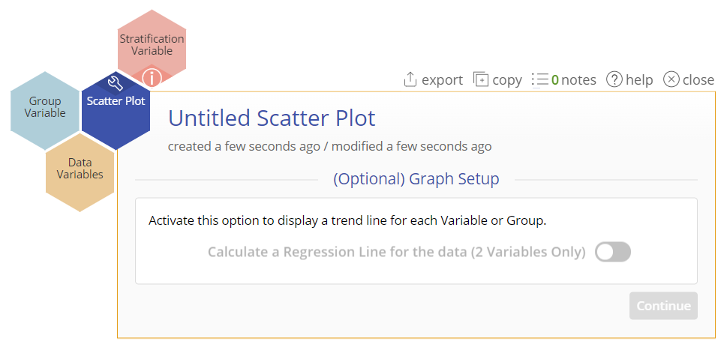
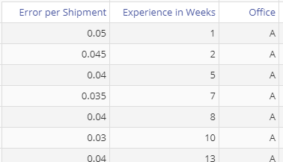
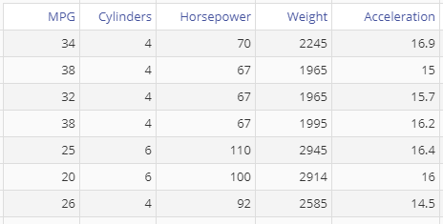
Using EngineRoom
The scatter plot requires at least two numeric samples of the same size or one numeric sample along with a categorical ID variable dividing the sample into two or more equal sized groups (i.e., each observation in group 1 MUST be paired with an observation in group 2).
Unstacked Data- each numeric sample in a separate column
Stacked Data- all numeric samples in a single column with the categorical group IDs in a second column
Unstacked Data
Stacked Data

Slide 4
Scatter Plot (Unstacked) Example
scatter_exmpldata.xlsx
Click on the data file in the data sources panel and drag the Experience in Weeks variable onto the tool’s Data Variable drop zone.
Note: The first data variable dragged onto the tool is automatically plotted on the X-axis.
A second Data Variable drop zone appears next to the first. Click and drag the Errors per Shipment variable onto this drop zone.
Note: The second data variable dragged onto the tool is automatically plotted on the Y-axis.
You can select the optional graph feature “Calculate a regression line for the data” but this is only available for a Scatter Plot with two data variables at this time.
Click "Continue.”

Slide 5
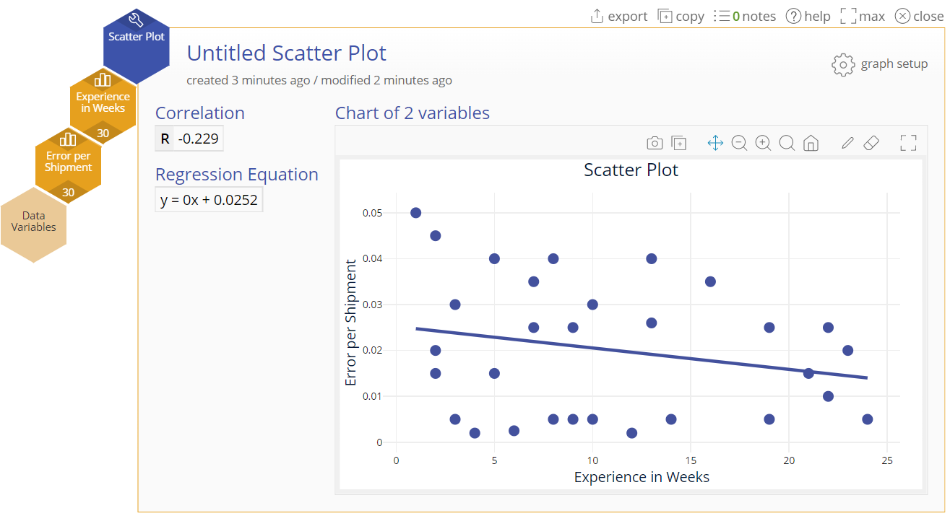
Scatter Plot (Unstacked) Output
Notes:
Output Note:
The output includes the scatter plot and numeric output showing the correlation coefficient between the two variables (a number between -1 and +1). Additionally, the regression line equation between the two variables is shown if the regression line option was chosen.
Note:
Click on the "graph setup" button above the graph and to turn the regression line option on or off.
*The samples/groups must be of equal size because the data are plotted as paired observations.

Slide 6
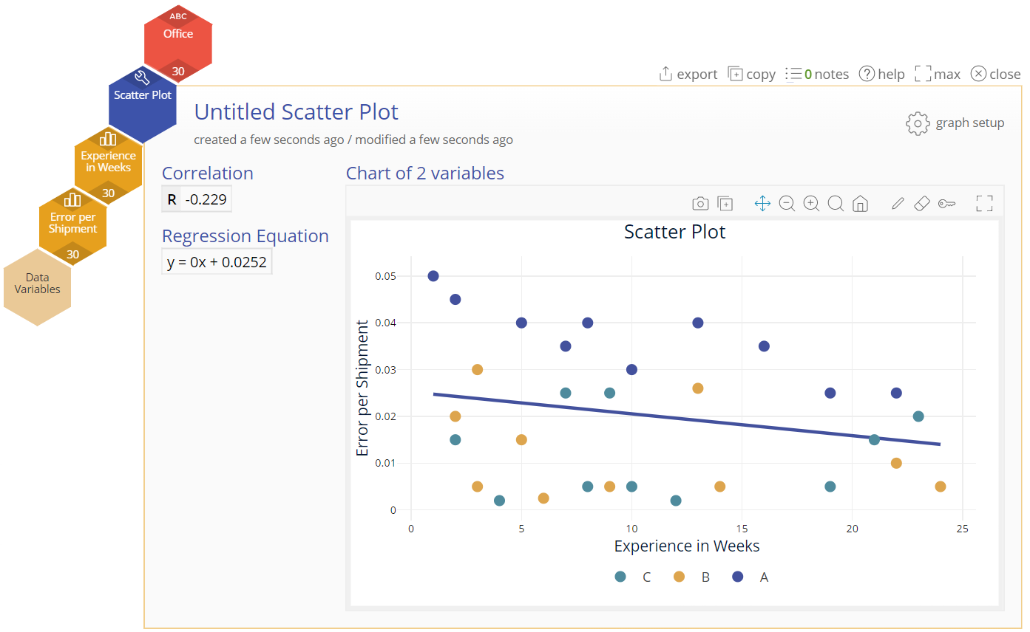
Scatter Plot (Unstacked & Stratified) Example
Suppose you want to know which office corresponds to each of the plotted data pairs – in other words, you want to stratify the data by the variable Office.
Repeat the previous steps to build the Scatter Plot.
Drag the Office variable onto the Stratification Variable drop zone to get the stratified scatter plot:
Notes:
Output Note:
The three offices are now color coded in the scatter plot so you can see a somewhat negative correlation between Errors per Shipment and Experience in Weeks at office A but not at the other two offices.
Note:
You can get the same graph with the data formatted so that all numeric values are in one column and the group IDs are in another.
The Stratification variable must have at least two levels/categories, though they need not be of equal size.

Slide 7
Matrix Plot (with Stratification Variable) Example
We will use the data in the “Car MPG” tab from the data sheet provided. The data set contains five numeric variables but “Cylinders,” though formatted as numeric, is categorical with three levels: 4, 6, and 8.
Click on the data file in the data sources panel and drag MPG, Horsepower, and Weight onto the Data Variable drop zones on the tool (new drop zones appear when you drag a data variable on).
Drag the categorical Cylinders variable onto the Stratification Variable drop zone.
Click “Continue.”

Slide 8
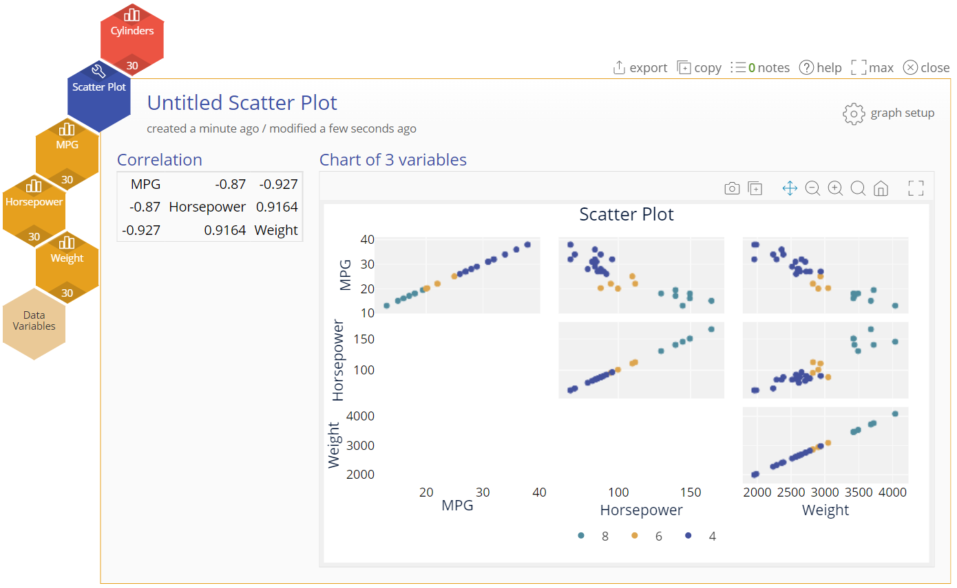
Matrix Plot (with Stratification Variable) Output
Notes:
Note:
The output includes a scatter plot of each pair of data variables stratified by Cylinders and a table showing the correlation coefficients of each data variable pair.

