Slide 1
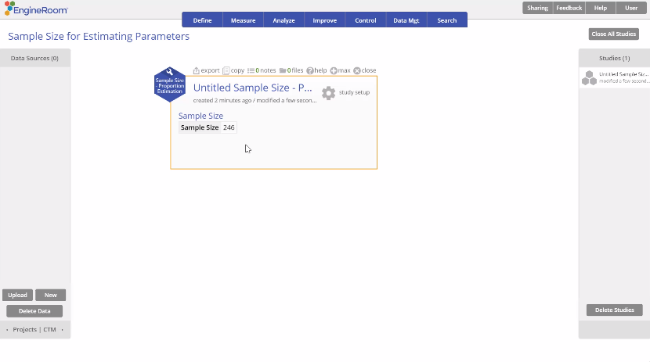
Sample Size – Proportion Estimation
When to use this tool
Use the Sample Size Calculator to obtain the sample size required to estimate a population proportion with a specified confidence level and precision (margin of error).
The calculator displays the sample size required to estimate the true value of the proportion with the desired precision and confidence for a large or infinite population.
Tutorial:
https://media.moresteam.com/university/tutorials/nonint/new/SampleSize.mp4

Slide 2
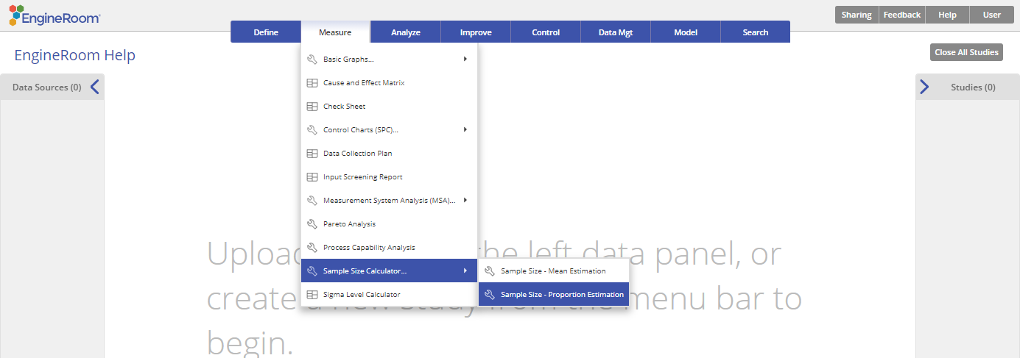
Using EngineRoom
Measure > Sample Size Calculator > Sample Size – Proportion Estimation

Slide 3
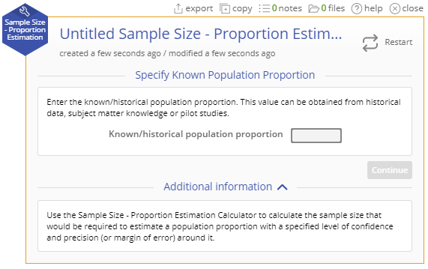
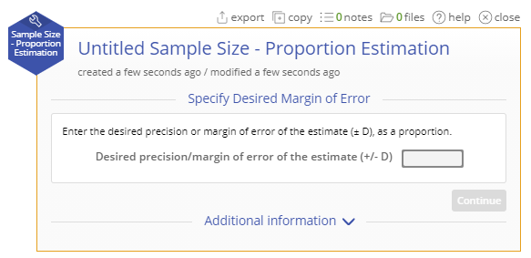
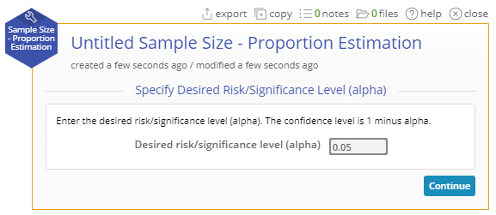
Sample Size – Proportion Estimation Example
Find the sample size required to estimate the population proportion given the following information:
Historical value for the proportion = 0.8
Desired margin of error = +/- 0.05
Desired significance level (= 1 - desired confidence level) = 1 - 0.95 = 0.05
Steps:
Follow the 3 Specification windows and enter the given information.
Enter the historical proportion value as 0.8.
Click "Continue."
Enter the desired margin of error as 0.05.
Click "Continue."
Enter the significance level (alpha) as 0.05.
Click "Continue."

Slide 4
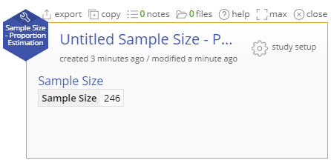
Sample Size – Proportion Estimation Output
The study displays the sample size required to estimate the population proportion for the given inputs.
In this example, it is 246.

