Slide 1
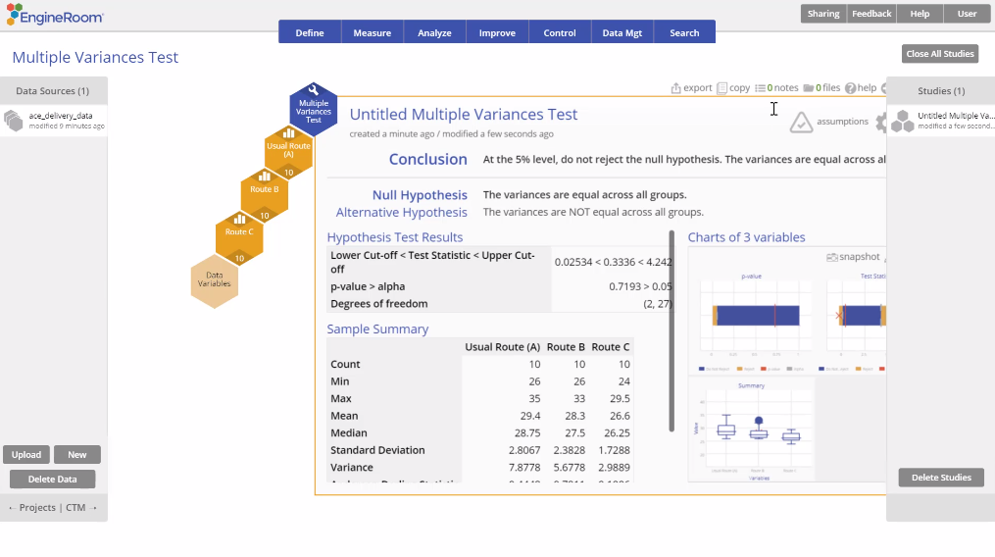
Multiple (>2) Variances Test
When to use this tool
Use the Multiple (> 2) Variances Test, also called the Homogeneity of Variances test, to compare the variances of multiple independent populations. For example, you want to run an ANOVA to test whether 3 group means are the same, but you first have to validate that the variances of the 3 groups are equal, to satisfy the equal variances assumption made by the ANOVA test.
EngineRoom uses the Modified Levene test to evaluate the variances, which makes the following assumptions:
The data variables are continuous.
The observations within the variables are randomly sampled.
The data variables are independent of each other.
Tutorial:
https://media.moresteam.com/university/tutorials/nonint/new/multi_var.mp4
Notes:
Note:
You must have raw data to run this test. Summary data cannot be used to run the Multiple Variances test.
This test does not require that the groups be normally distributed.

Slide 2
Using EngineRoom
Analyze > Parametric > Multiple Variances Test

Slide 3
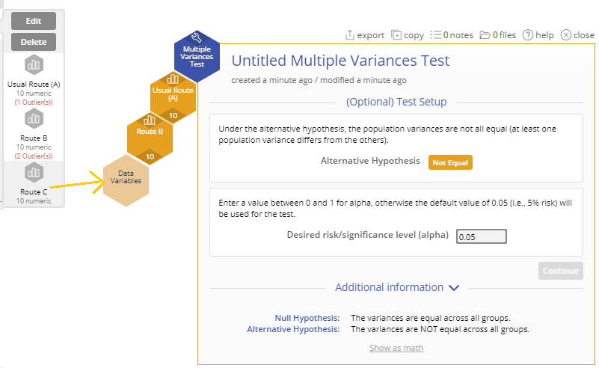
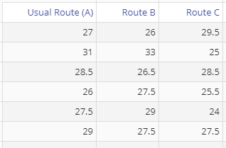
Multiple Variances Example
ace_delivery_data.csv
You can only use this test on raw data. The data variables may be in separate columns, or in a single column with a second column containing the group IDs.
Steps:
Drag each route variable onto the Data variable drop zones which appear on the study.
Click “Continue”:
In this example, we have data on the time taken to complete deliveries using three different routes. We will use the standalone Multiple Variances test from the Parametric menu to test whether the route variances differ significantly.

Slide 4
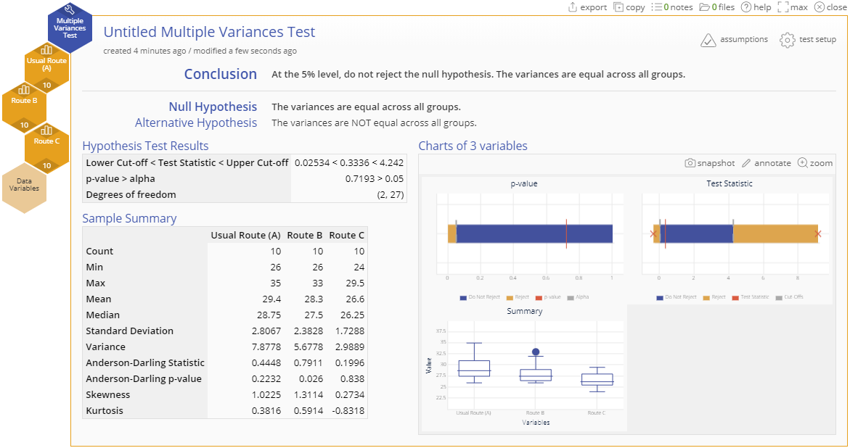
Multiple Variances Output
Notes:
Output Notes:
The large p-value shows that the test is not significant - we can conclude that the variances do not differ significantly and proceed with the ANOVA test.
The ANOVA test procedure runs this test in the background as part of the assumptions check, so you do not have to run it before using an ANOVA test in EngineRoom.

