Slide 1

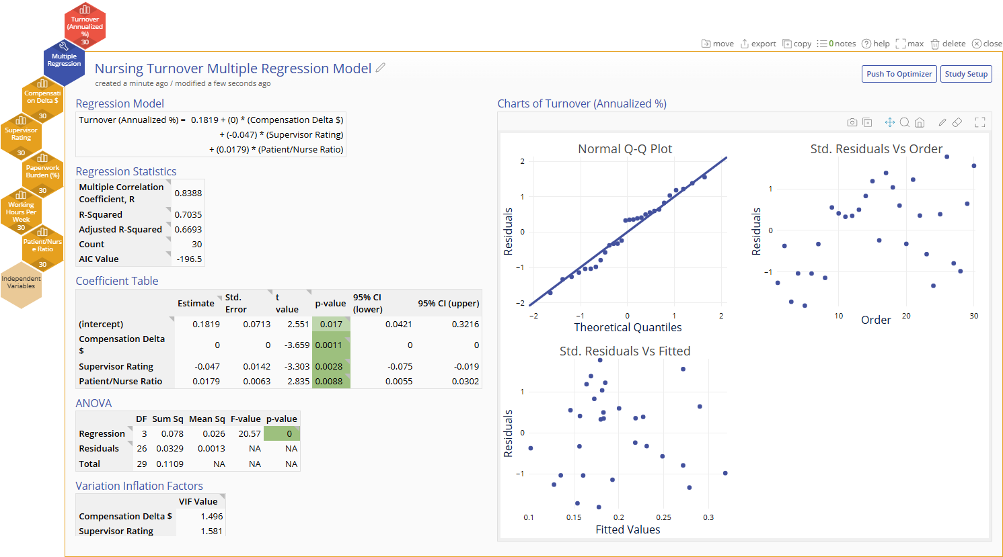
Multiple Regression Analysis
When to use this tool
  Use Multiple Regression Analysis to explain the relationship between one continuous dependent/output (Y) variable and multiple independent/input (X) variables. The response output variable is assumed to be continuous.
  Multiple Regression analysis models the data using a linear equation of the form:
  Y = a + b₁X₁ + b₂X₂ + …b_{k}X_{k}+ e
  where
  Y = the dependent output or response variable; assumed to be continuous
  a = the constant term (value of Y when all inputs are set
  to zero)
  X₁, X₂, .…X_{k} = the k independent inputs or predictor variables. These can be continuous or categorical.
  b₁, b₂, ...b_{k} = the coefficients corresponding to the k inputs
  e = error or unexplained variance
Tutorial:
https://media.moresteam.com/university/tutorials/nonint/new/multi_reg_2.mp4

Slide 2
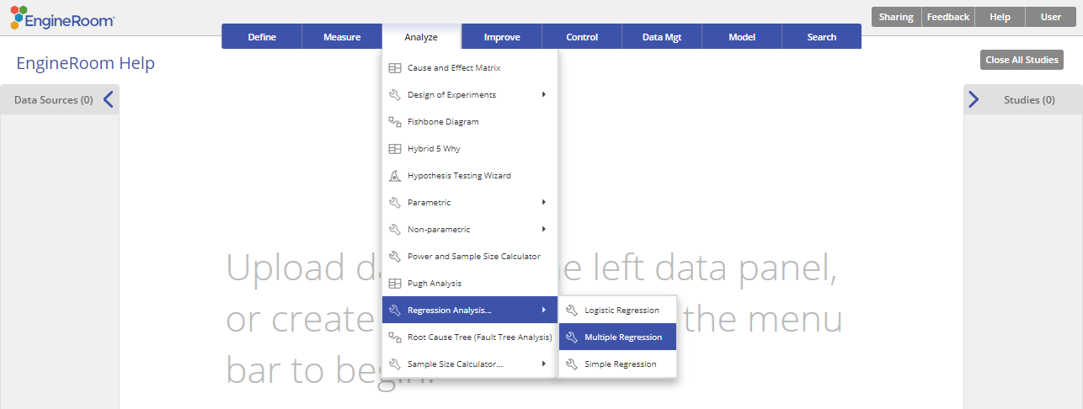
Using EngineRoom
Analyze > Regression Analysis > Multiple Regression

Slide 3

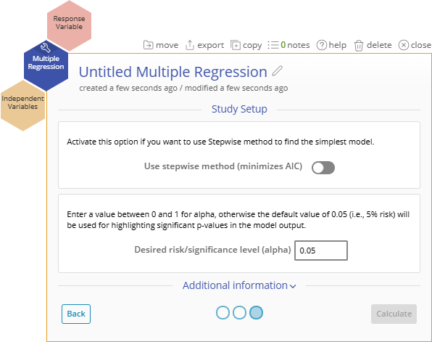
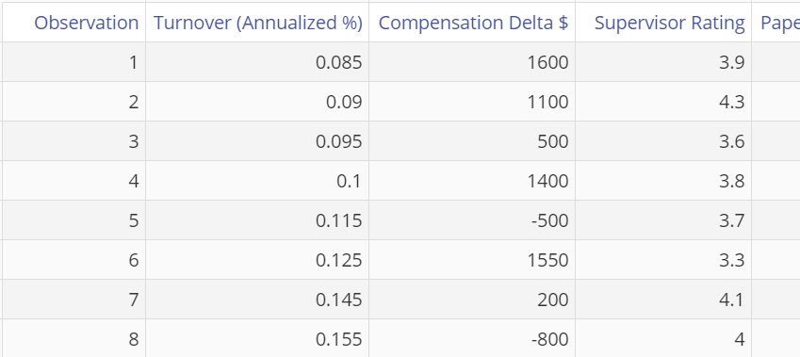
Multiple Regression Example
nurse_turnover_data.xlsx
Steps:
Click on the data file in the Nurse turnover data source and drag each of the input variables, Compensation Delta, Supervisor Rating, Paperwork Burden, Working Hours Per Week and Patient/Nurse Ratio onto the Independent Variables drop zone.
Drag Turnover (Annualized %) onto the Response Variable drop zone.
At this point you can select the Stepwise method to automate the model selection and arrive at the best model based on the backwards stepwise AIC method. Do not select this option yet.
Enter the value of the desired risk or significance level (this should be a value between 0 and 1, conventionally 0.05 or 0.1) or leave the default value of 0.05 as is. Let’s use the default value in this case.
Click “Continue”
Notes:
Note:
Nominal (categorical with multiple levels) X variables must be converted to binary indicator/dummy variables before using them in the analysis.
The example below is worked out with the Guided Mode disabled, so it combines some steps in one dialog box. You can enable or disable Guided Mode from the User menu at the top right of the EngineRoom workspace.

Slide 4
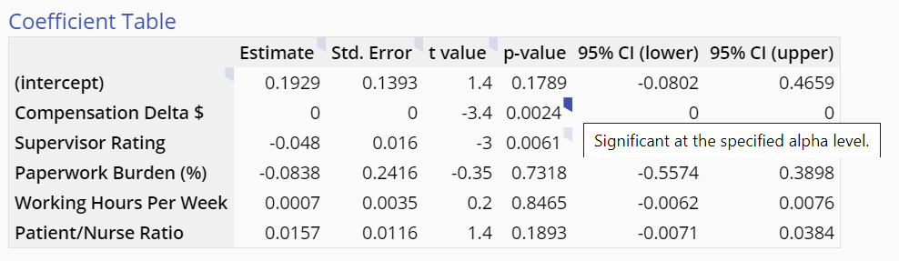
Multiple Regression Example Output
Notes:
Output Notes:
All of the X variables dragged on to the study are included in the model. The significant p-values are flagged.
At this point you can simplify the model manually by dragging off individual non-significant X variables one at a time until all the terms remaining in the model are significant.

Slide 5

Multiple Regression Example Output
Alternatively, you can click the Study Setup button in the top right corner of the study to open the panel and select the option ‘Use stepwise method’ to select the model for you.
Doing so and clicking ‘Save changes’ displays the final model with only the significant terms included…

Slide 6
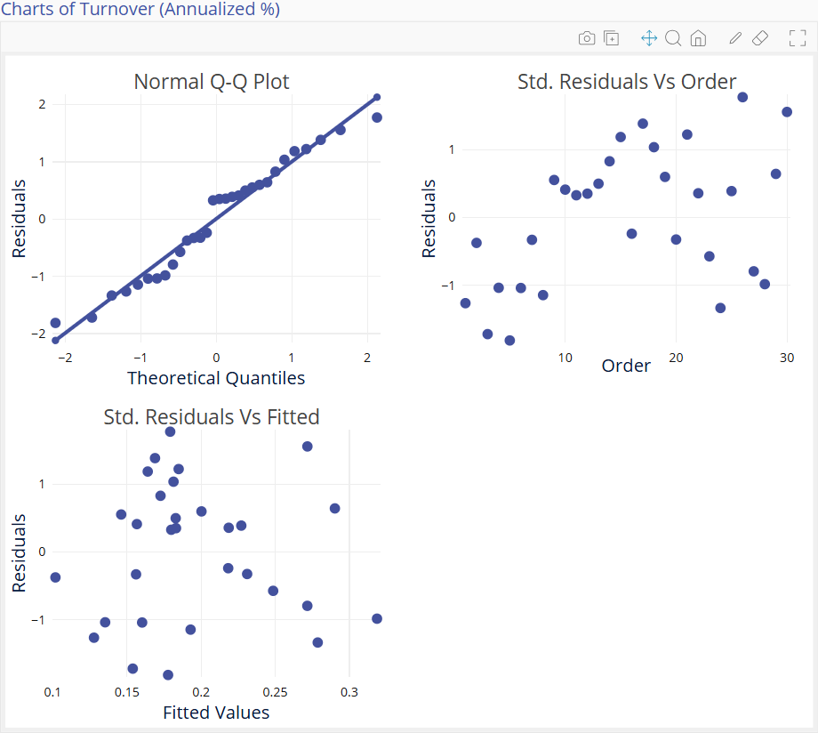
Multiple Regression Output
The Multiple Regression Analysis output includes graphical and numeric output.
The graphical output contains three residual plots:
Normal Q-Q (quantile- quantile) plot which is like a probability plot. If the plotted points fall along the diagonal line, the assumption of normally distributed residuals holds.
Scatter plot of Standardized residuals vs. the time order of the observations. If the plotted points are randomly scattered with no patterns or trends, the assumption of independent residuals holds.
Scatter plot of Standardized residuals vs. fitted values (predictions of the data observations using the regression model). If the plotted points are randomly scattered with no patterns or trends, the assumption of equal variances holds. This plot is also used to detect non-linearity and outliers.

Slide 7
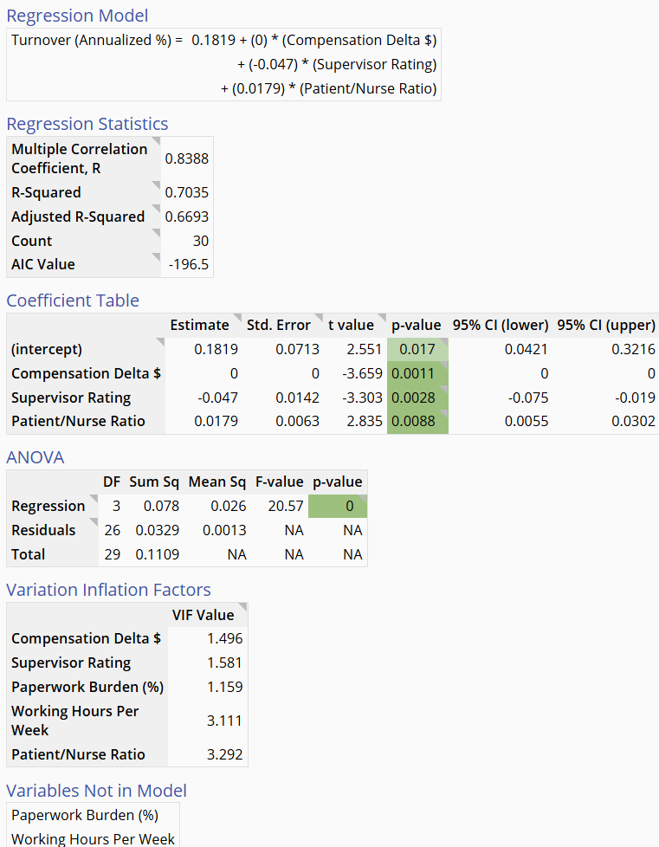
Multiple Regression Output
The numeric output contains:
Regression model expressed as a mathematical equation
Regression statistics table
Coefficient Table
ANOVA table
Variation Inflation Factor table
Variables Not in Model table (shown only if the automated stepwise option is chosen)

