Slide 1
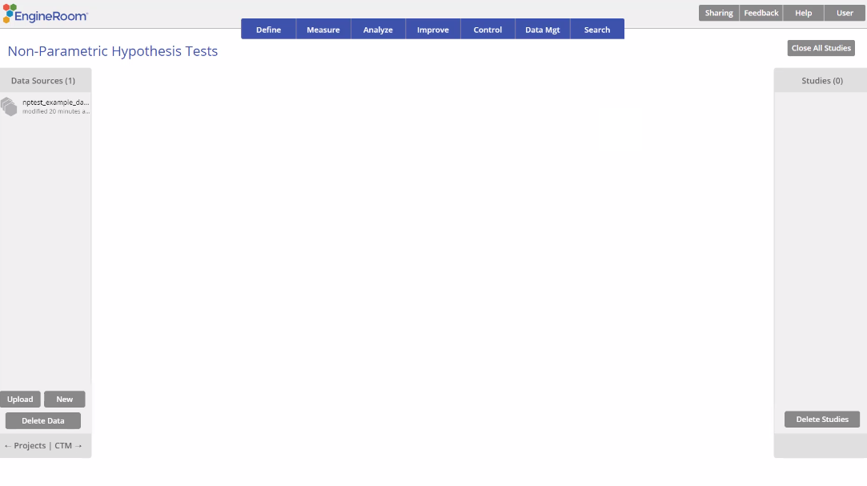
Independent Samples Kruskal Wallis Test
When to use this tool
The Kruskal Wallis Test is used to compare the medians of three or more independent, continuous populations. As an example, three treatments are administered to randomly sampled groups of patients and their median scores on a reaction time test compared.
The Kruskal Wallis test makes the following assumptions:
The data are continuous numeric.
The units are randomly sampled.
The groups are independent of each other.
The groups have equal variances.
Tutorial:
https://media.moresteam.com/university/tutorials/nonint/new/non_param_onesign.mp4

Slide 2
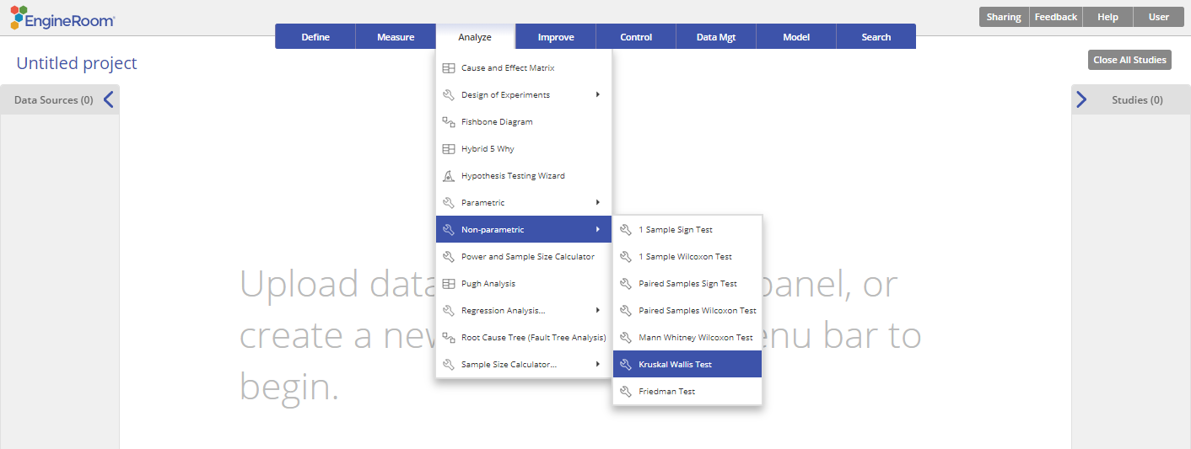
Using EngineRoom
Analyze > Non-parametric > Kruskal Wallis Test

Slide 3
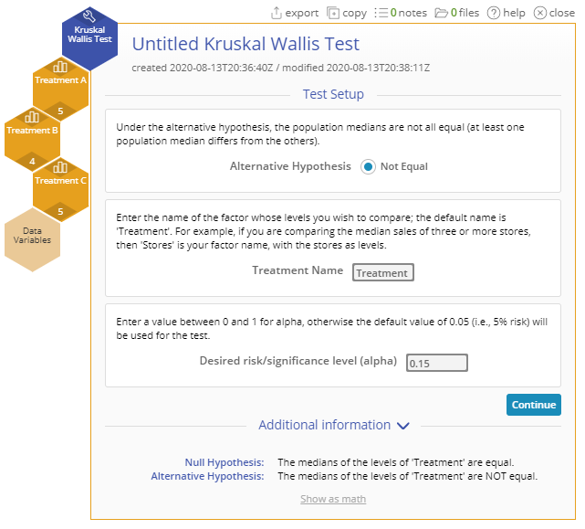
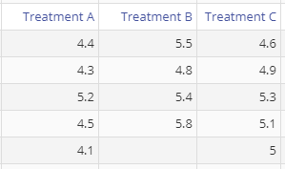
Kruskal Wallis Test Example
nptest_example_datasets.xlsx
Steps:
Click on the data file in the data sources panel and drag the three Treatment variables onto the Data variable drop zones on the study.
Set up the test as shown, and click Continue:
You must have raw data to run this test. Non-parametric tests cannot be run with sample summary data.
Example:
The data for this example consists of three samples of scores representing reduction in pain, for each treatment group: A, B and C. We want to test, at the 15% level, whether the reduction in pain differs across treatments.
Notes:
Treatment Name: “Treatment”
Desired risk/significance level (alpha): 0.15

Slide 4
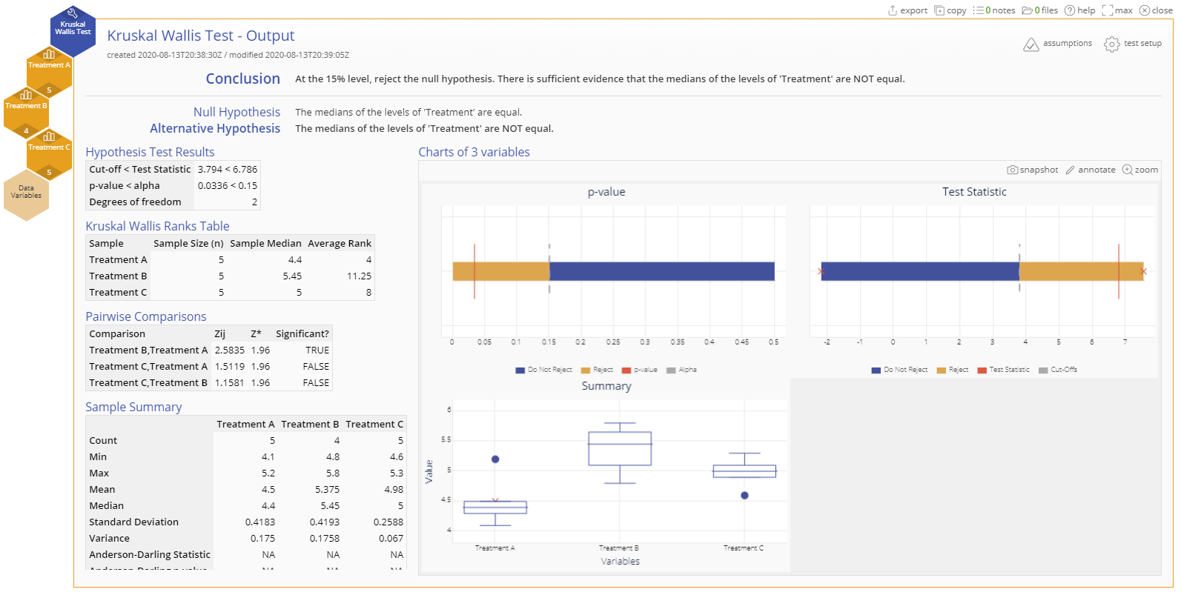
Kruskal Wallis Test Example Output
Notes:
Conclusion
The p-value is less than the chosen significance level of 15%, so reject the null hypothesis
at least one treatment differs significantly from the others at the 15% level
The Pairwise Comparisons table shows that, in particular, Treatments A and B differ significantly

