Slide 1
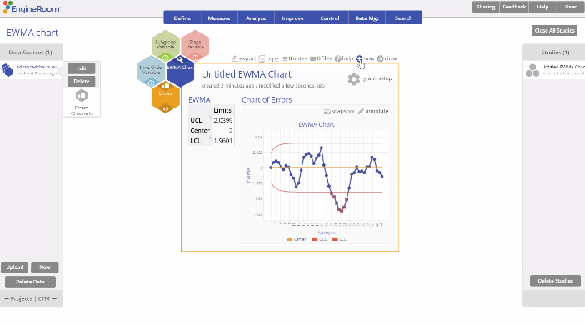
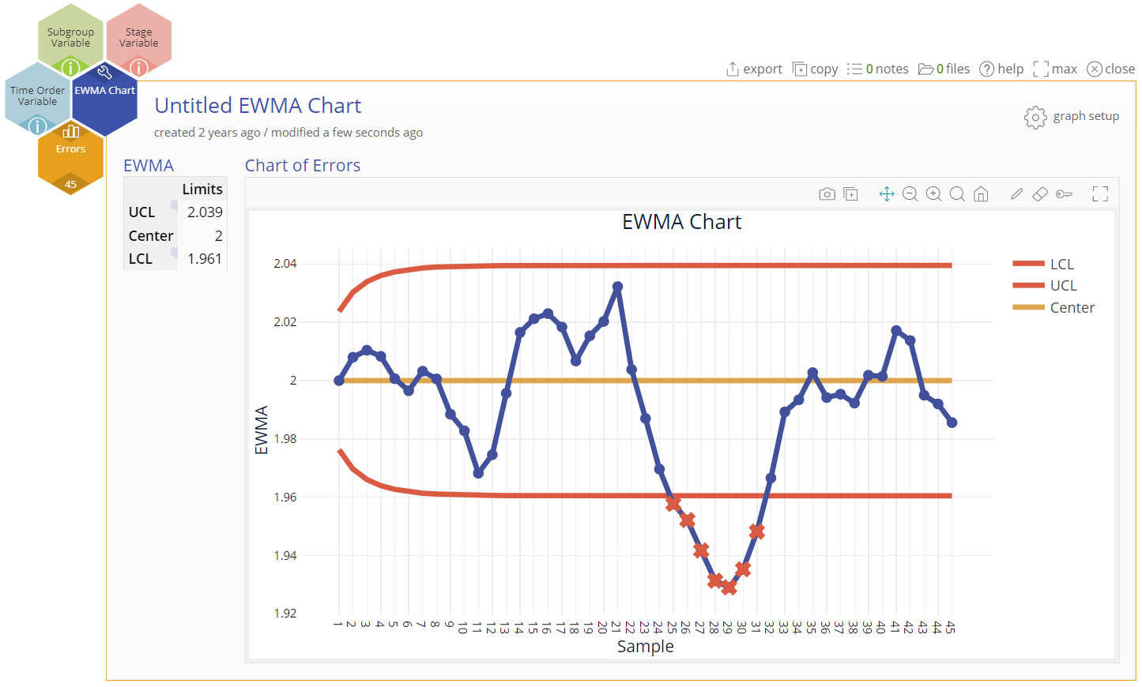
Attribute Control Charts (EWMA Chart)
When to use this tool
Use the Exponentially Weighted Moving Average (EWMA) Chart to detect small shifts in the mean of a continuous process. The EWMA Chart is better than a Shewhart control chart for this purpose because it incorporates data from past subgroups into the plotted points, making the chart more sensitive to small shifts.
In order to use this chart in EngineRoom, the subgroups must be individual observations (subgroup size = 1) or of equal size (n = constant).
While all the previous data are included at each step, you can decide how much influence they have on the weighted moving averages by the choice of the weighting factor (w). With this approach, the weight of older subgroups decreases exponentially as new samples are obtained.
Tutorial:
https://media.moresteam.com/university/tutorials/nonint/new/EWMA.mp4

Slide 2
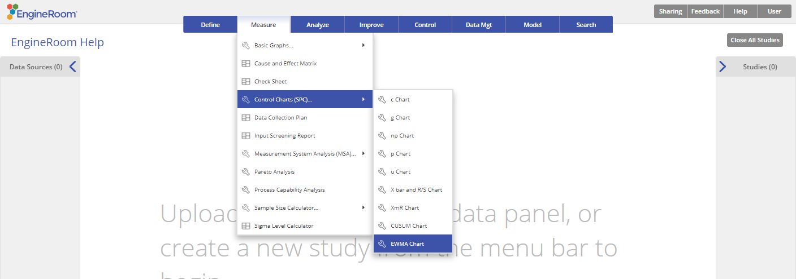
Using EngineRoom
Measure > Control Charts (SPC) > EWMA Chart

Slide 3
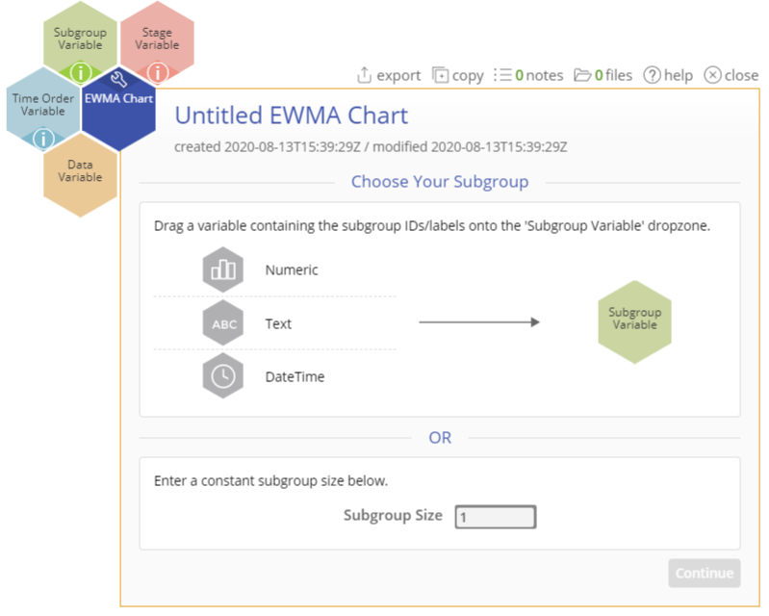
Using EngineRoom
To use the EWMA Chart, collect observations on at least 20 individual units or 20 subgroups over time.
There are four “drop zones” attached to the study:
Data Variable (required): For the measurement data variable. This variable must be numeric.
Subgroup Variable: For the variable containing the subgroup IDs. If you don't have a subgroup variable, you can ignore this drop zone and simply enter the constant size in the dialog box provided. This variable can be numeric or text.
Time Order Variable (optional): Use if you have a variable containing the time stamps for the subgroups. This variable can be numeric or date/time.
Stage Variable (optional): Use if you have a variable identifying different stages (such as “before” and “after” an improvement initiative). This variable can be numeric, text, or date/time.

Slide 4
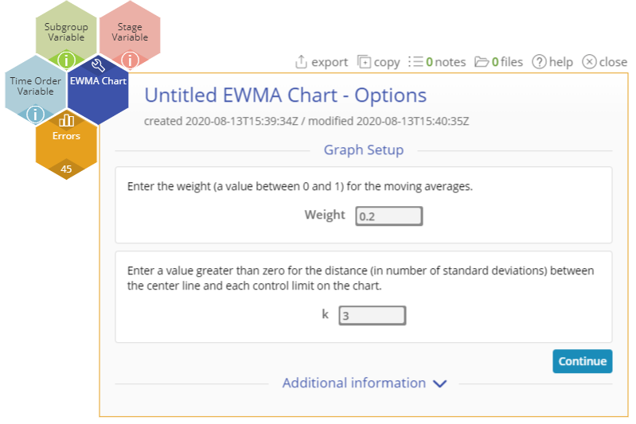
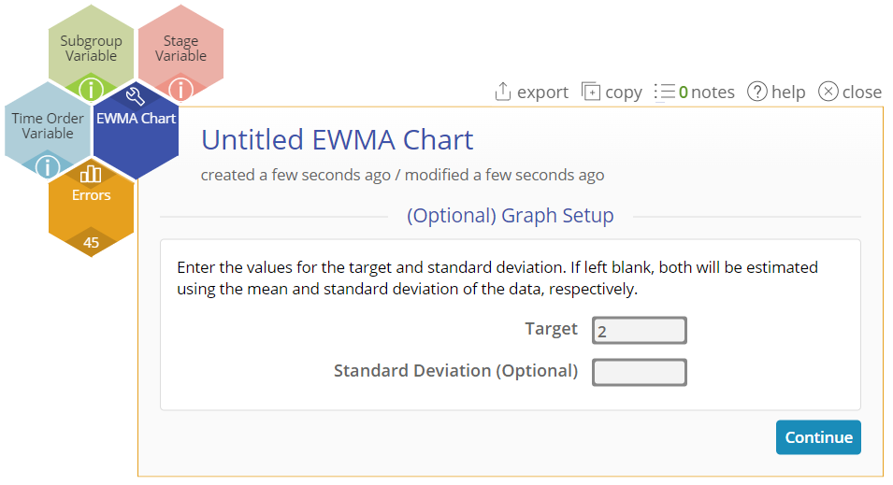
EWMA Chart Example
advancedcharts_exampledata_errors.xlsx
The data set provided contains a column (Errors) containing the difference of 45 daily measurements of groundwater effluent concentrations compared with the standard.
Click on the data file in the data sources panel and drag Errors onto the Data Variable drop zone.
Leave the default values of the weight (w) = 0.2 and k (shift) = 3 as is.
Click “Continue.”
Enter the Target value = 2 and an optional standard deviation if you have it.
Click “Continue.”

Slide 5
EWMA Example Output
Notes:
Output Note:
The EWMA Chart output includes the EWMA control chart and a table listing the center (target) as well as upper and lower control limits
To edit the chart, click on the plotted points or lines and select the options for thickness, color, and style.
Select the graph setup button to change any of the parameter values previously entered.

