Slide 1
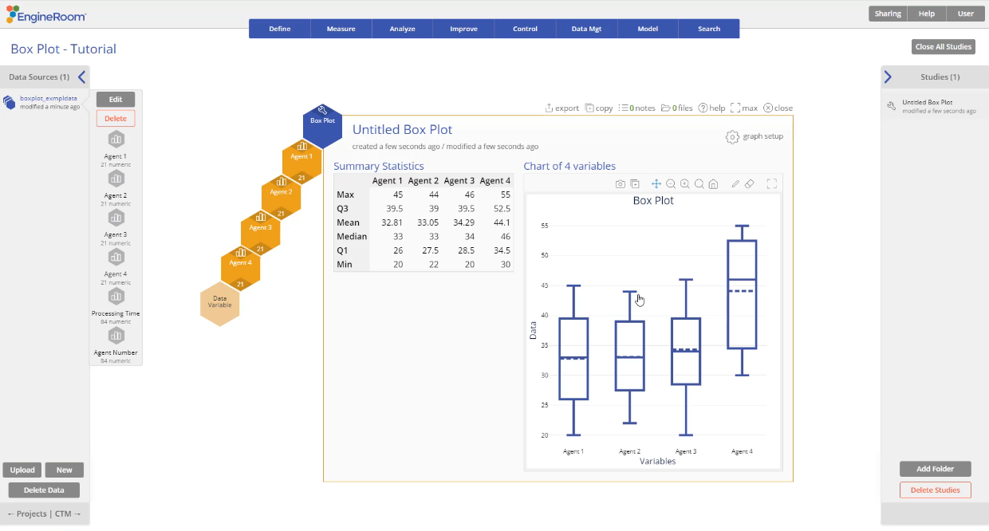
Box Plot
When to use this tool
Use the Box Plot to investigate the skewness (degree of asymmetry) of a set of data or to graphically compare the effect of multiple categorical inputs (e.g., locations) on a continuous output (e.g., sales).
Tutorial:
https://media.moresteam.com/university/tutorials/nonint/new/BoxPlot.mp4

Slide 2
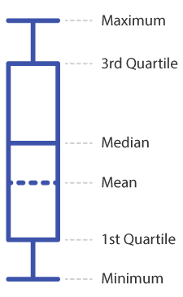
About Box Plots
The Box Plot displays the following characteristics of the data:
Maximum: Plotted as the minimum of (the maximum value in the data set, Q3 + 1.5 * IQR).
3rd Quartile (Q3): The 75th percentile of the data set.
The box portion of the Box Plot represents the Inter-quartile Range (IQR) (i.e., area between Q1 and Q3). This is calculated as IQR = Q3 - Q1.
Median: The 50th percentile of the data set. Also called 2nd Quartile or Q2.
Mean: The average value in the data set.
1st Quartile (Q1): The 25th percentile of the data set.
Minimum: Plotted as the maximum of (the minimum value in the data set , Q1 - 1.5 * IQR).

Slide 3
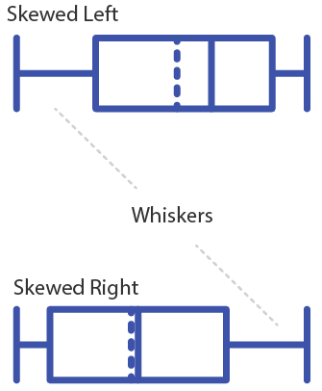
About Box Plots
Whiskers: The lines extending from Q3 to the Maximum and from Q1 to the Minimum.
Outliers: Data points that lie beyond the IQR-based minimum or maximum, i.e. beyond Q1 - 1.5 * IQR or Q3 + 1.5 * IQR, are marked with asterisks (*)
The shape of the Box Plot can provide a clue as to the skewness (degree of asymmetry) of a distribution:
If the line ("whisker") connecting the box to the Minimum is longer, the data are skewed left (i.e., the distribution has a longer left tail).
If the whisker connecting the box to the Maximum is longer, the data are skewed right (i.e., the distribution has a longer right tail).

Slide 4
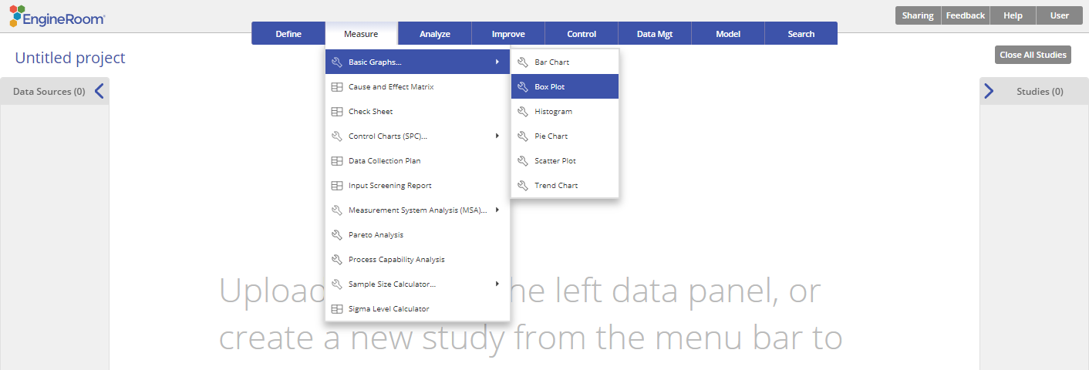
Using EngineRoom
Measure > Basic Graphs > Box Plots

Slide 5
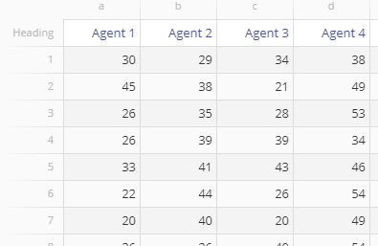
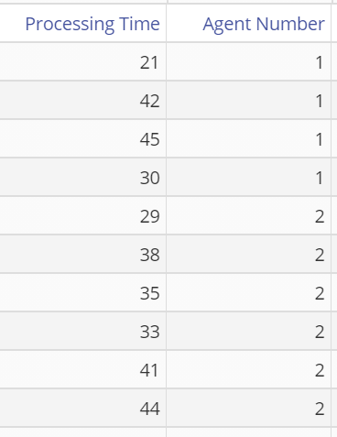
Using EngineRoom
boxplot_exmpldata.xlsx
The Box Plot requires at least one numeric sample (unstacked data)
or one numeric sample along with a categorical ID variable dividing the sample into two or more groups (stacked data).

Slide 6
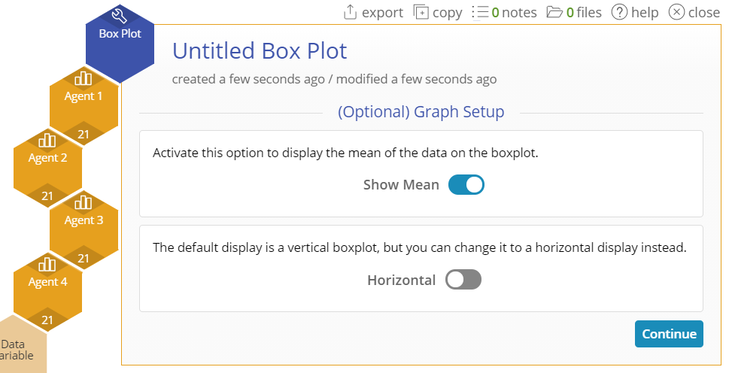
Box Plot Example (Unstacked Data)
The data set consists of four columns of data showing the time taken on service calls for each of four agents.
Drag the Agent 1 variable onto the Data Variable drop zone.
A second Data Variable drop zone appears next to the first. Click and drag the Agent 2 variable onto this drop zone. Do the same with the remaining Agent variables.
Once the data are selected, you can select the optional graph features: Show the mean on the Box Plot and display the Box Plot as a horizontal graph rather than the default vertical orientation. Below, we turned on “Show Mean”.
Click “Continue”.

Slide 7
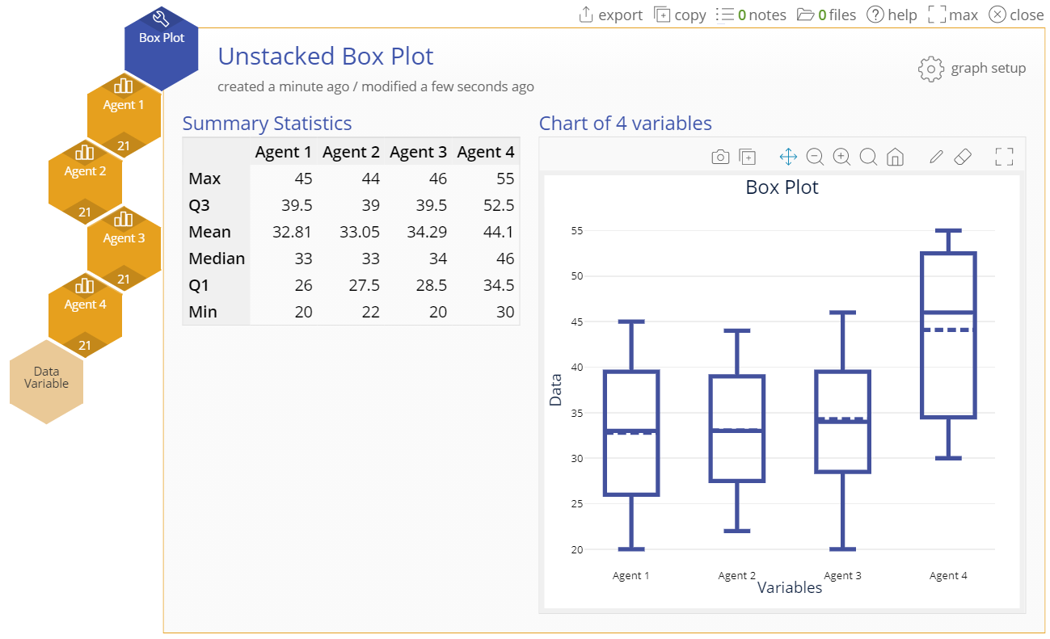
Box Plot Unstacked Example Output
Notes:
Note:
The output includes a summary descriptive statistics table alongside the side-by-side Box Plots

Slide 8
Box Plot Example (Stacked Data)
The same data on agents are now stacked, with all the service times in a single numeric column and the agents identified in a Group variable column.
Click on the data file in the data sources panel and drag the Processing Time variable onto the tool’s Data Variable drop zone.
Click and drag the Agent Number variable onto the Group Variable drop zone.
Select any optional graph features. For this example, we turned on “Show Mean”.

Slide 9
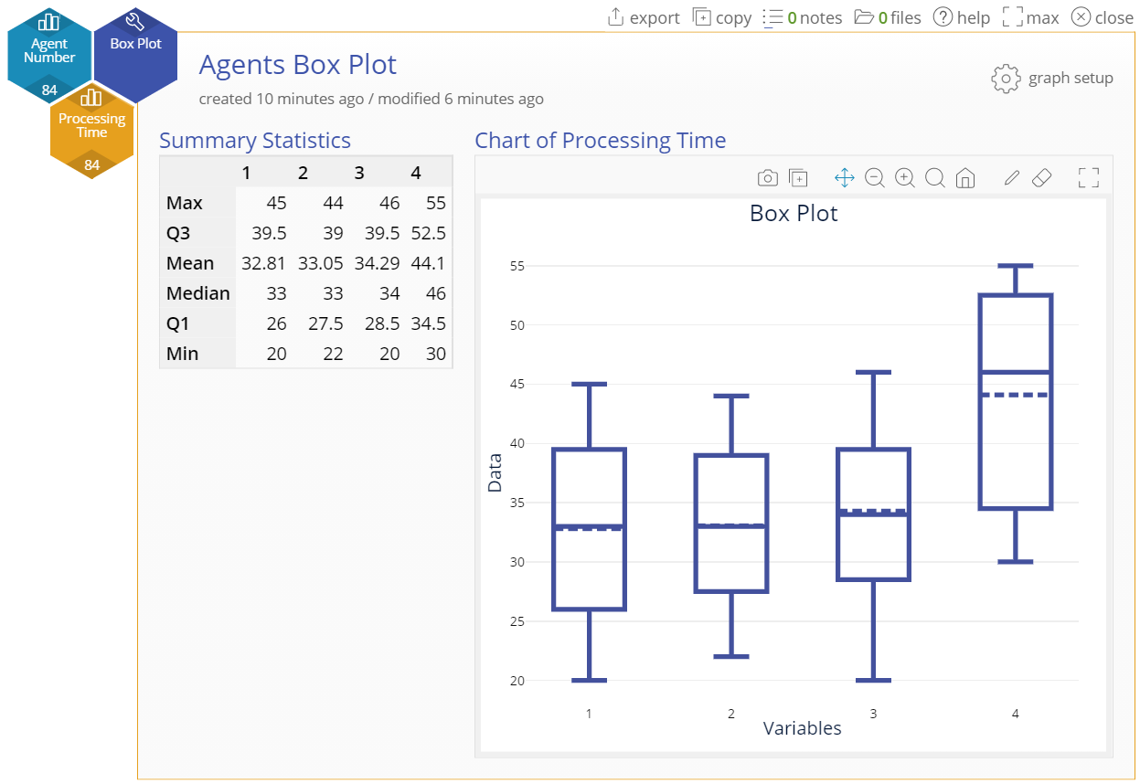
Box Plot Stacked Example Output
Notes:
Note:
The Box Plot looks identical to the one using unstacked data columns, given that it is the same data in a different format

