Slide 1
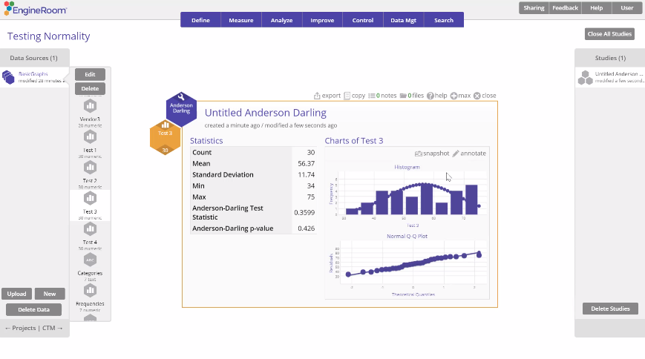
Anderson Darling Normality Test
When to use this tool
The Anderson Darling (AD) Normality Test is used to test whether a set of continuous data is likely to have come from a normal distribution.
The null and alternative hypotheses for this test are, respectively:
H₀: The data follow a normal distribution
H₁: The data DO NOT follow a normal distribution
The test measures the differences between the standard normal distribution and the observed distribution of the sample data. Reject the null hypothesis if the p-value of the test is smaller than your specified alpha level. Rejecting the null hypothesis means the data distribution is unlikely normal.
Tutorial:
https://media.moresteam.com/university/tutorials/nonint/new/ad_test.mp4
Notes:
Notes:
Hovering over the variable in the variable panel shows a histogram of the data along with the AD test statistic and p-value.
The AD test has low power to reject H0 when the sample is small (n < 20) and may be overly sensitive (i.e., rejects H0 too often) when the sample is large (n > 1000). Use a reasonably sized sample (n ~ 30 to 100) when running this test.
Failing to reject the null hypothesis does not necessarily mean the data follow a normal distribution; it simply means no significant departure from normality was detected.

Slide 2
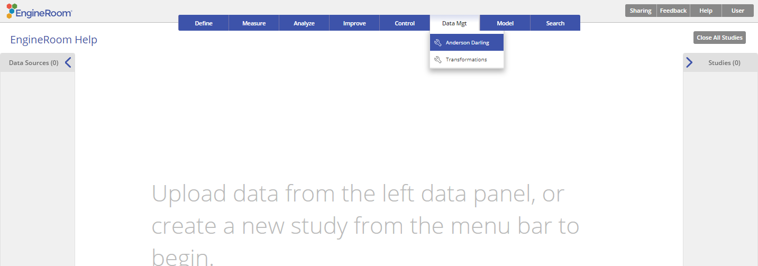
Using EngineRoom
Data Mgt > Anderson Darling

Slide 3
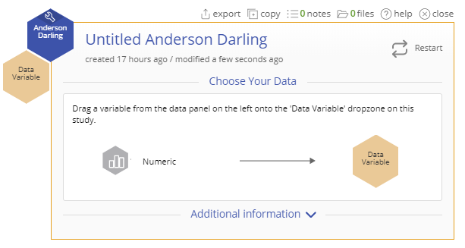
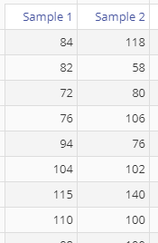
Using EngineRoom
To use the AD Normality Test, collect at least 30 observations or subgroups.
The data set provided contains two columns of data (Sample 1 and Sample 2) of size 30 each. Here, we run the test on each sample at the 5% alpha level.

Slide 4
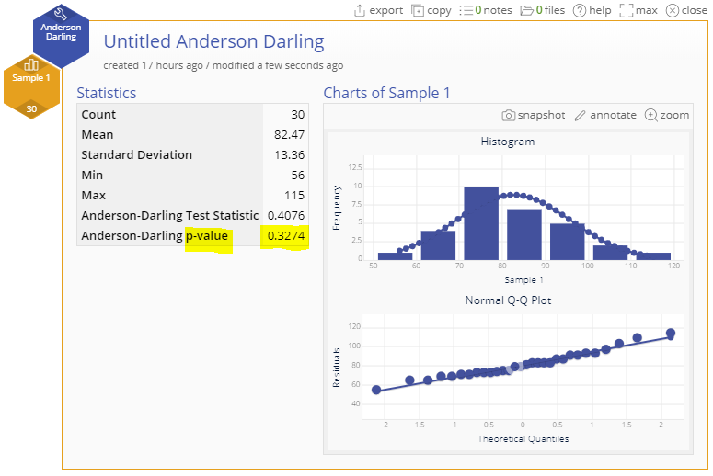
Anderson Darling Example
ADnormality_test_data.xlsx
Click on the data file in the data sources panel and drag Sample 1 onto the Data Variable drop zone.
The AD Normality Test fails to reject the null hypothesis (p-value = 0.3274 > 0.05).

Slide 5
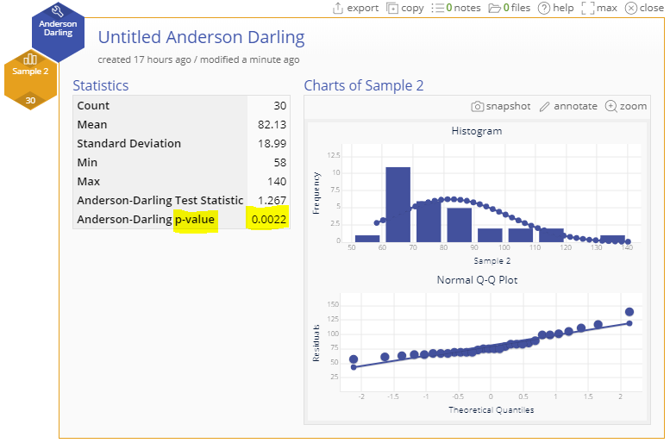
Anderson Darling Example
Drag off the Sample 1 variable (or close the study and open a new one)
Drag on the Sample 2 variable.
This time the test rejects H0 (p-value = 0.0022 < 0.05).
Notes:
Output Notes:
The test output includes a histogram with an overlaid normal distribution, a normal probability (QQ) plot, and a table of descriptive statistics, along with the AD test statistic and p-value.
Sample 1, therefore, appears normally distributed and Sample 2 appears to be not normally distributed.
Next, we can use the Transformations tool to convert the Sample 2 variable to a normal variable.

