Slide 1
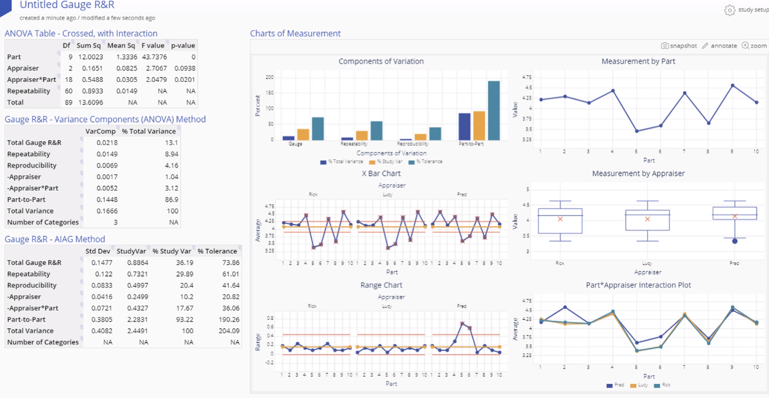
Gauge R&R
When to use this tool
Use the Gauge R&R tool to quantify measurement error and ensure that it is at an acceptable level before conducting analysis on data and making business decisions based on it. Gauge R&R differentiates the measurement variation due to different sources: the parts or process units, the appraisers/operators doing the measuring, and the variation in repeated measurements taken using the same gauge.
EngineRoom Web uses the Components of Variation approach to Gauge R&R analysis through the ANOVA technique.
Tutorial:
https://media.moresteam.com/university/tutorials/nonint/new/gauge_rr.mp4

Slide 2
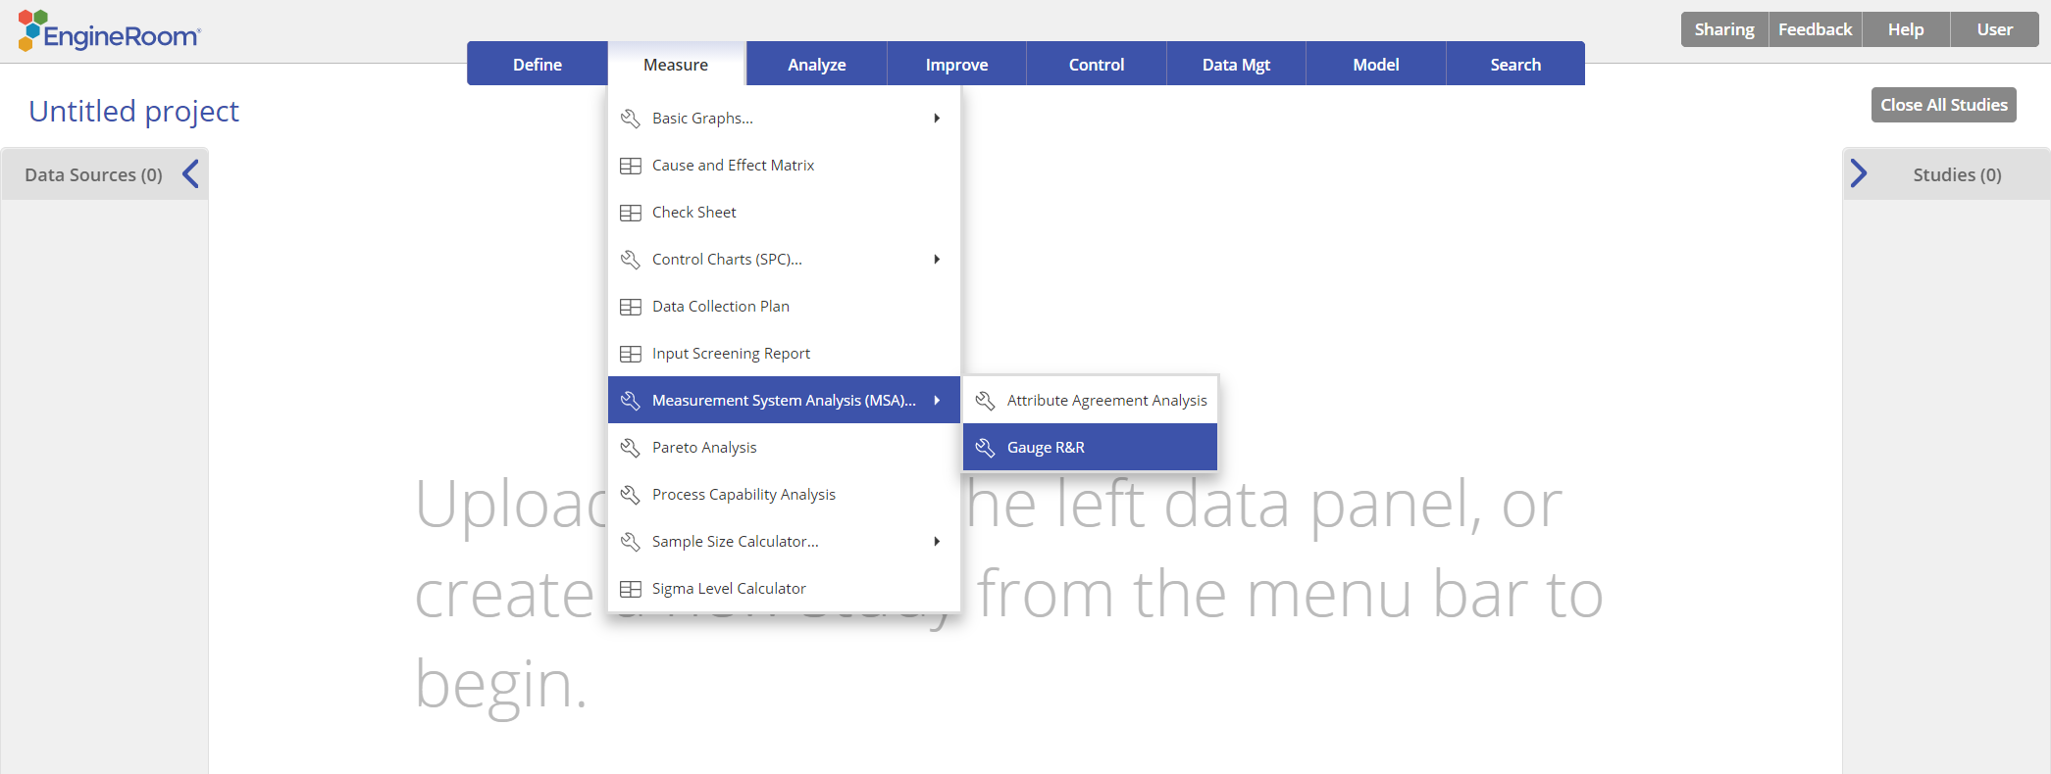
Using EngineRoom
Measure > Measurement System Analysis (MSA) > Gauge R&R

Slide 3
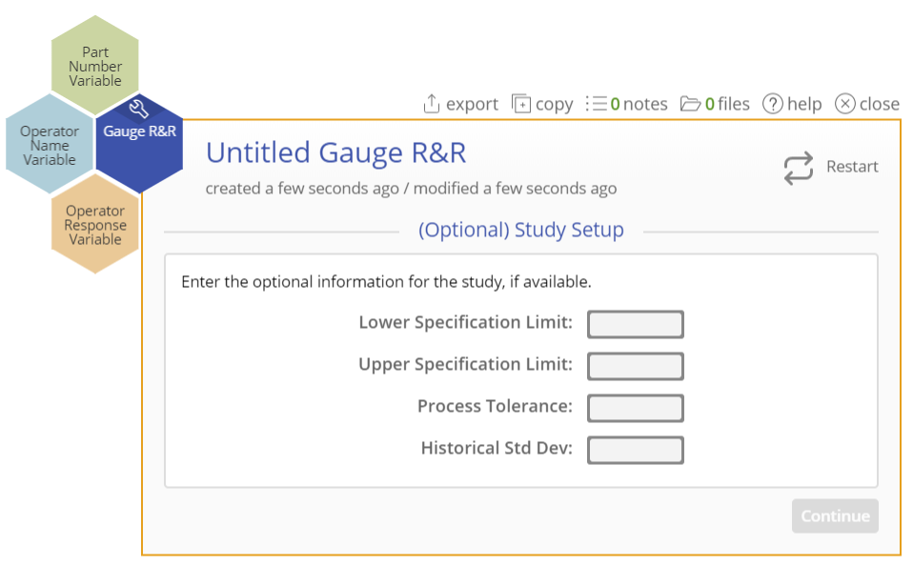
Using EngineRoom
There are 3 “drop zones” attached to the study:
Part Number Variable (required): for the variable containing the part numbers. Can be numeric or text.
Operator Name Variable (required): for the variable identifying the operator names. Can be numeric or text.
Operator Response Variable (required): for the variable containing the measurement data from the study. Must be numeric.

Slide 4
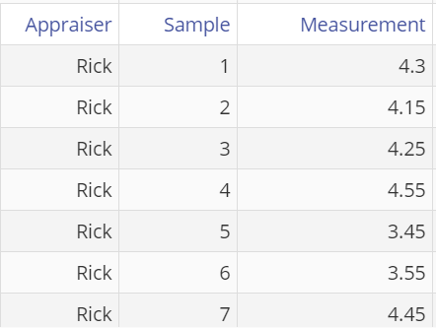
Gauge R&R Example
New_VariablegaugeRandR_data.csv
The data set contains measurement data of 10 samples (parts) taken by each of three appraisers over three trials. A tolerance of +/- 0.6 is associated with the samples.
Open the data source to see three column of data: Appraiser (with the names of the three appraisers), Sample (for the part numbers) and Measurement (for the measurement data gathered by the appraisers).
Each sample number is repeated three times for each appraiser, representing the three trials.

Slide 5
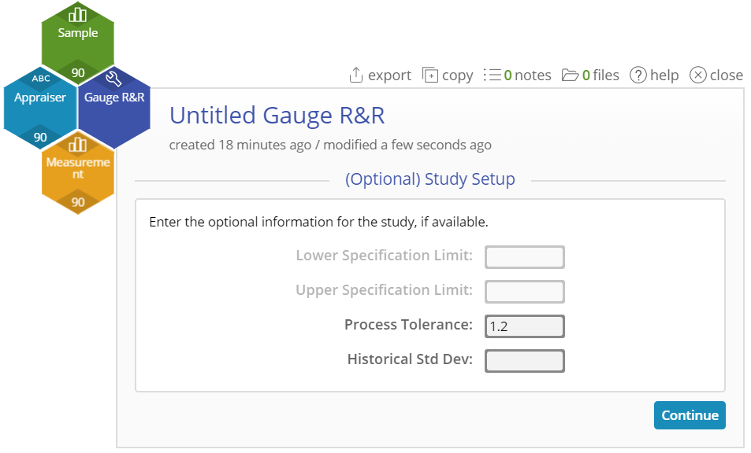
Gauge R&R Example
Click on the data file in the data sources panel and drag Sample onto the Part Number Variable drop zone.
Drag Appraiser onto the Operator Name Variable drop zone.
Drag Measurement onto the Operator Response Variable drop zone.
Now you can enter any of the optional parameters for the study, such as upper or lower specification limits, tolerance or historical standard deviation. Enter the tolerance value of 1.2.
Click “Continue”.

Slide 6
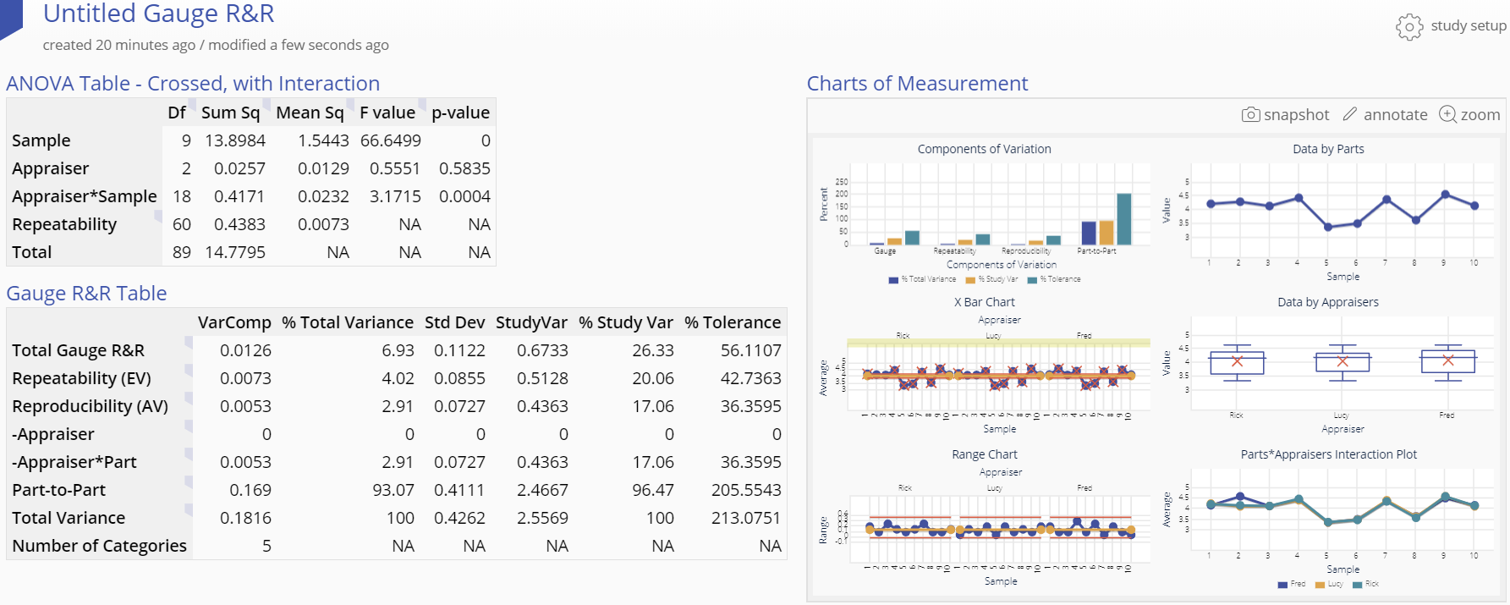
Gauge R&R Output
Notes:
The Gauge R&R output includes graphical and numeric output.

Slide 7
Gauge R&R Output
The graphical output contains:
Components of Variation bar chart
Xbar Chart (you want to see at least 50% of the points falling outside limits on this chart)
Range Chart (you want to see points falling within limits on this chart)
Data by Parts chart
Data by Appraisers chart
Parts by Appraisers Interaction Chart

Slide 8
Gauge R&R Output
The numeric output contains:
The ANOVA Table - Crossed, with Interaction (if the interaction is not significant, a second ANOVA table is displayed without the interaction term where the interaction variance is combined with the repeatability (error) variance.
The Gauge R&R table which contains the components of variance output, including %Total and %Study variance.
Note:
The % Tolerance column is displayed only if you entered at least one specification limit value or a tolerance value in the study setup dialog.
Entering an historical standard deviation value in the setup creates an additional column in the Gauge R&R table called % Process.

