Slide 1
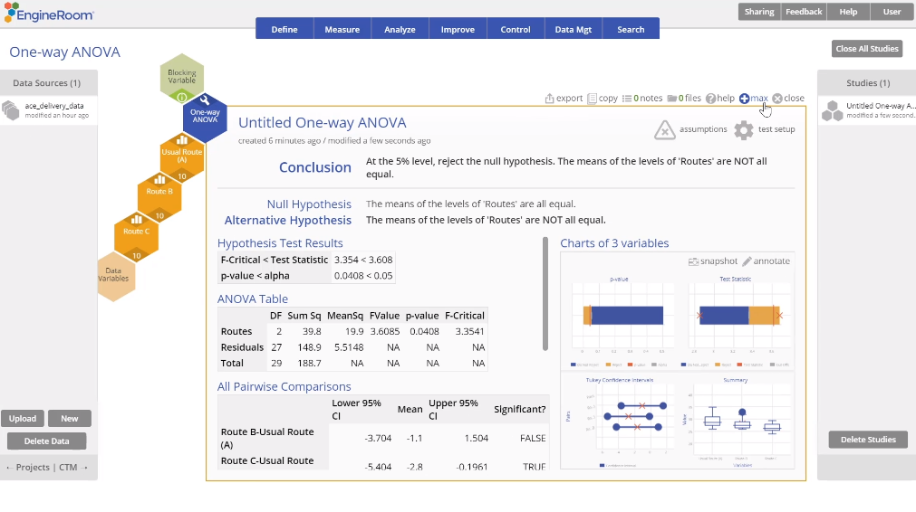
One-Way ANOVA (Independent Samples)
When to use this tool
Use the One-Way Analysis of Variance (ANOVA) Test to check the equality of three or more means from independent groups/populations. As an example, you can test whether the mean 'taste' score is the same across different brands of ice cream, based on a taste test with numeric scores.
The test makes the following assumptions:
The data are continuous numeric.
The units are randomly sampled.
The groups are independent.
The groups are normally distributed.
The groups have equal variances.
Note: You must have raw data to run this test. Summary data cannot be used to run the ANOVA.
Tutorial:
https://media.moresteam.com/university/tutorials/nonint/new/anova.mp4
Notes:
Notes:
ANOVA assumes the underlying data distributions are normal and that the variances are equal across the populations.
This test is robust to the violation of the normal distribution assumption for large samples. Similarly, the test is fairly robust to the violation of the equality of variances assumption IF all the samples are of the same size.

Slide 2
Using EngineRoom
Analyze > Parametric > One-way ANOVA

Slide 3
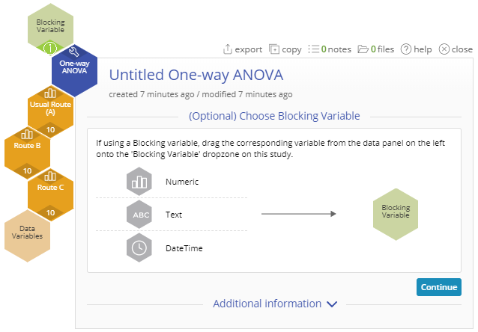
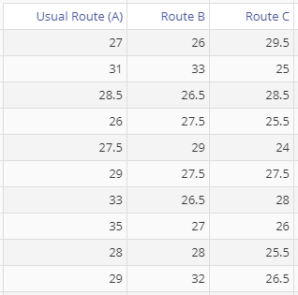
One-Way ANOVA Example
ace_delivery_data.csv
You can only use this test on raw data. The data variables may be in separate columns, or in a single column with a second column containing the group IDs:
Steps:
Drag each route variable onto the Data variable drop zones which appear on the study.
Click “Continue”.
Example:
In this example, we have data on the time taken to complete deliveries using three different routes.

Slide 4
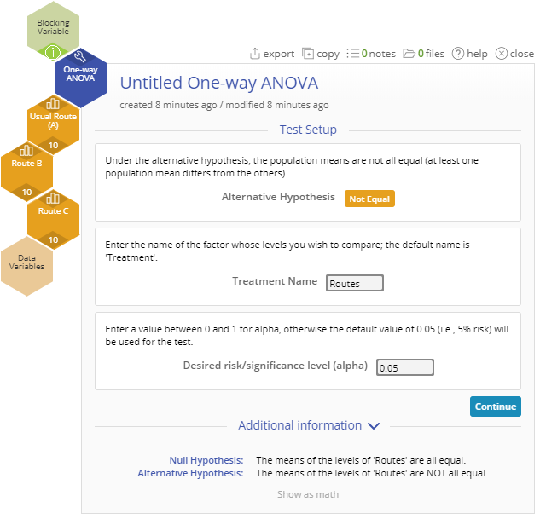
One-Way ANOVA Example
Set up the test as shown (Note: the only alternative is 'Not Equal', the Location variable in on the Blocking variable drop zone):
Treatment Name: “Routes”
Significance Level: 0.05
click “Continue”.

Slide 5
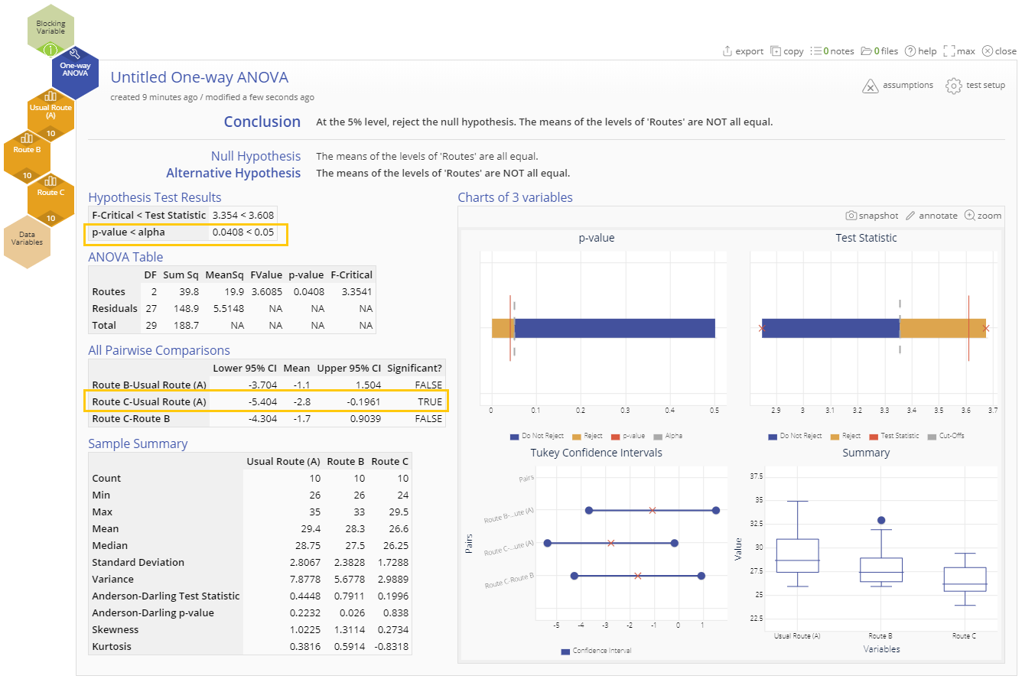
One-Way ANOVA Example Output
Notes:
Output Notes:
The output includes the ANOVA table showing the p-value. If the p-value is smaller than the chosen significance level (0.05 by default), then we reject the null hypothesis and conclude that the means differ significantly. This is the case in this example.
If the test is significant (i.e. we reject the null hypothesis), the next task is to identify which pair/s of means is/are different. Examine the All Pairwise Comparisons table in the output to get this information. In our example, the difference of means of Route C - Route A is significant, so route C differs significantly from route A. Further, this difference is negative (from the sign of the mean difference, -2.8) so we can say that the mean distance from route C is shorter than that from route A. Thus, route C is the shortest route.

