Slide 1
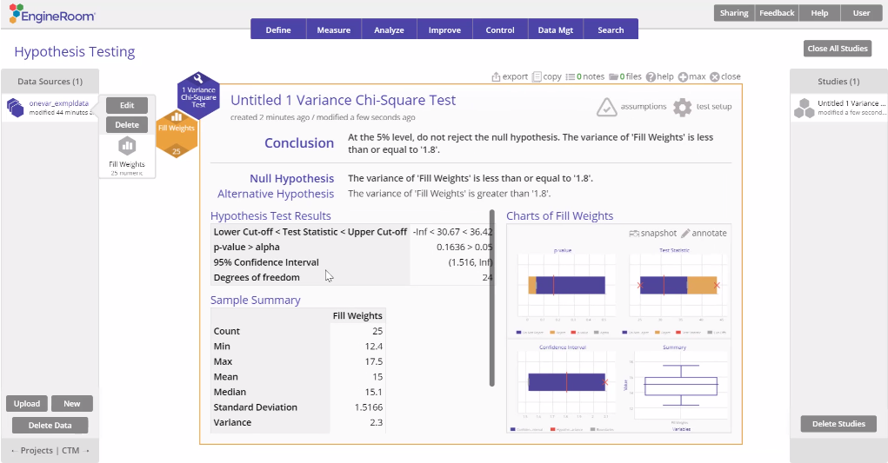
1 Variance Chi-Square Test
When to use this tool
Use the 1 Variance Chi-square test to compare the variance of a single population to a specified value. As an example, a post office is experimenting with a single queue feeding all its counters instead of multiple queues and wants to test whether a single queue reduces variation in wait times for customers, compared to the historical variation in the wait times.
The test makes the following assumptions:
The data are continuous numeric.
The units are randomly sampled.
The data are normally distributed.
Note: The 1 Variance test is sensitive to violations of the normal distribution assumption.
Tutorial:
https://media.moresteam.com/university/tutorials/nonint/new/one_var.mp4

Slide 2
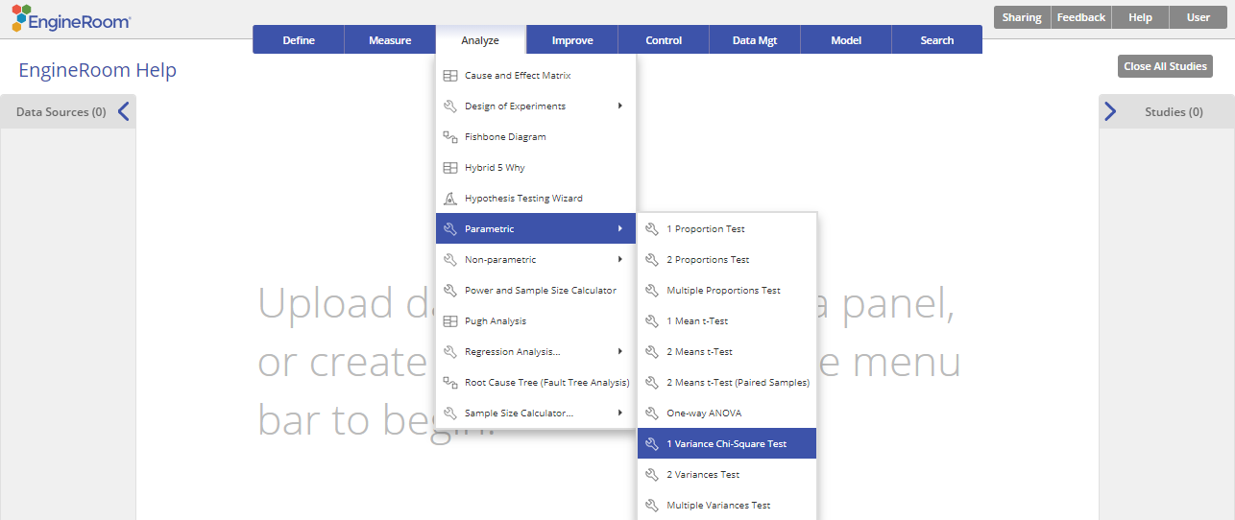
Using EngineRoom
Analyze > Parametric > 1 Variance Chi-Square Test

Slide 3
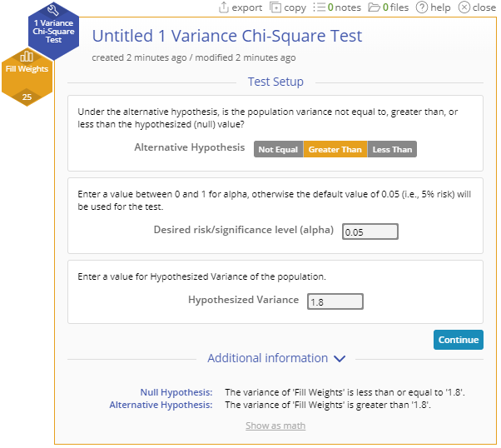
1 Variance Chi-Square (Raw Data) Example
onevar_exmpldata.xlsx
This test can be used on raw data (i.e., the actual sample measurements) or sample summary data in the form of the sample variance.
In this example, we want to test whether the fill weights of cereal boxes have a variance greater than 1.8 ounces² at the 5% level, using a random sample of 25 boxes.
For raw data use a single column of measurements:
Steps:
Drag the Fill Weights variable onto the Data variable drop zone on the study.
Click “Continue”.
Set up the test as shown, and click “Continue”

Slide 4
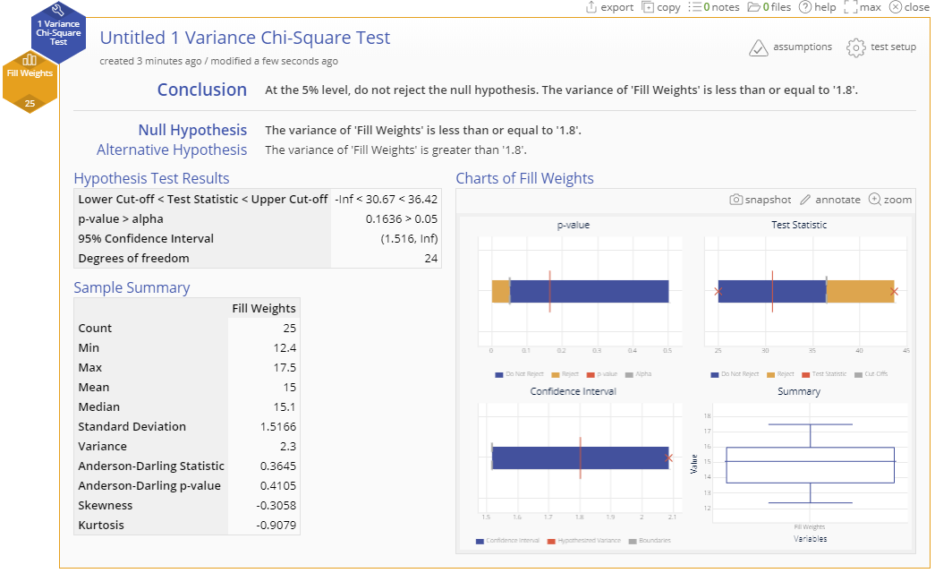
1 Variance Chi-Square (Raw Data) Output

Slide 5
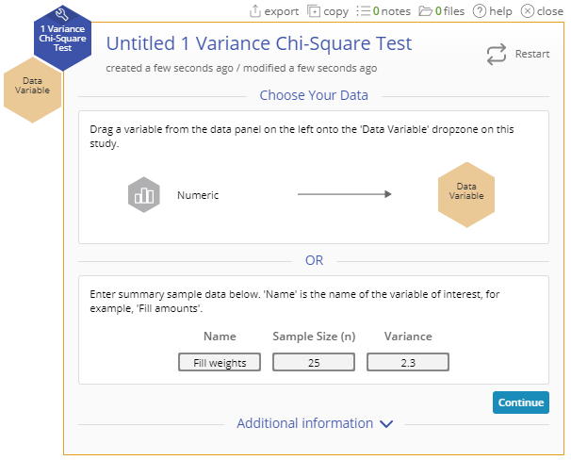
1 Variance Chi-Square (Summary Data) Example
Now let's run the same test using the summary statistics from the data: Given Sample size = 25 Variance = 2.3 ounces²
Steps:
Set up the test as shown:
Name: “Fill weights”
Sample Size (n): 25
Variance: 2.3
Click “Continue”
Fill out the Test Setup screen as before and Click “Continue”.

Slide 6
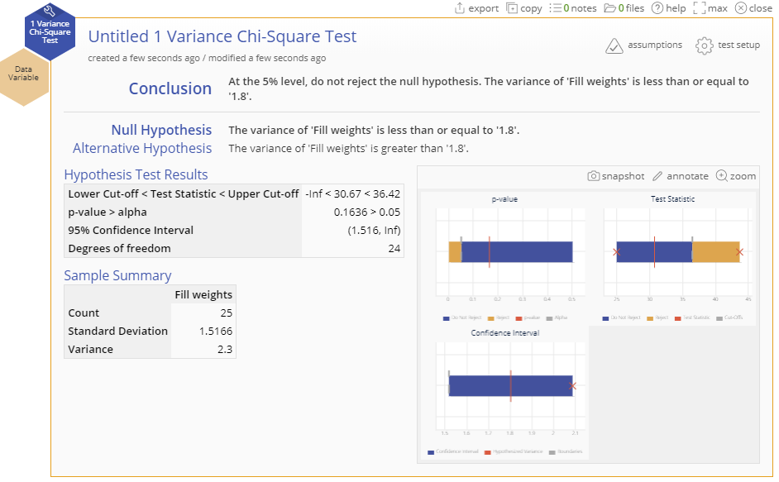
1 Variance Chi-Square (Summary Data) Output

