Slide 1
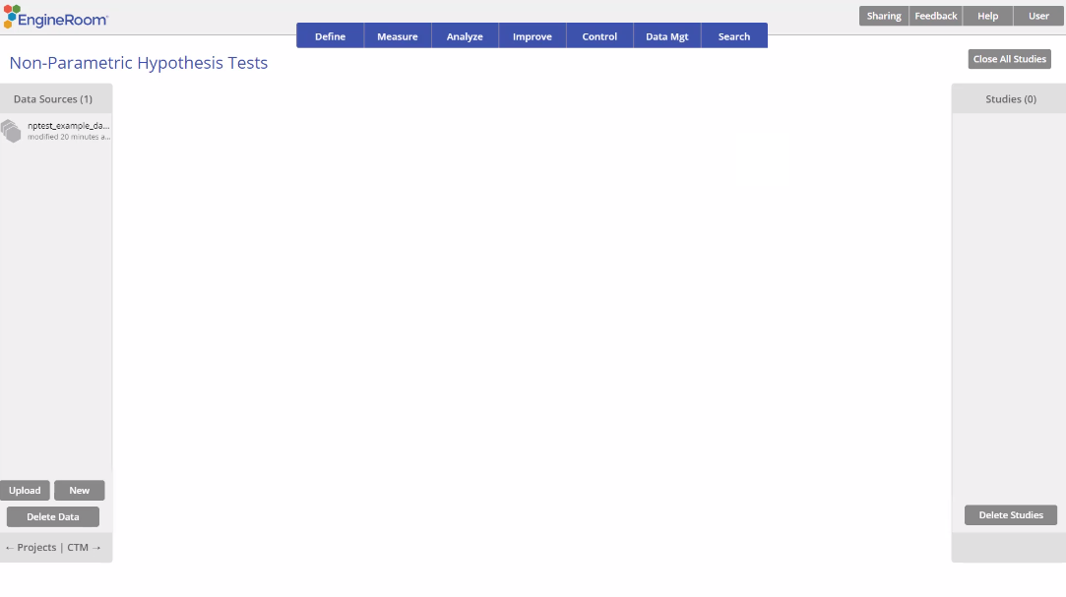
1 Sample Wilcoxon Signed Ranks Test
When to use this tool
Use the Wilcoxon Signed Ranks Test to compare the median (center) of a continuous population to a specified/historical value. As an example, an improvement team wants to test whether the median time to fill out extended warranty forms exceeds the historical median value.
The 1 Sample Wilcoxon Signed Ranks Test is based on the sum of the ranks of the observations that are larger than the test value of interest, so it takes more of the information available into account than the Sign test.
The test makes the following assumptions:
The data are continuous numeric.
The units are randomly sampled.
The data distribution is symmetric.
Note: No summary data option is available for this test. You must use a data variable.
Tutorial:
https://media.moresteam.com/university/tutorials/nonint/new/non_param_onesign.mp4

Slide 2
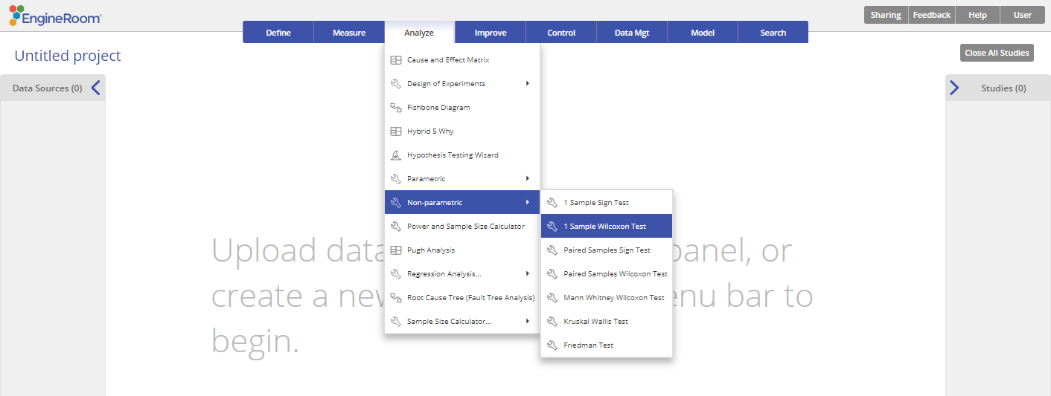
Using EngineRoom
Analyze > Non-parametric > 1 Sample Wilcoxon Test

Slide 3
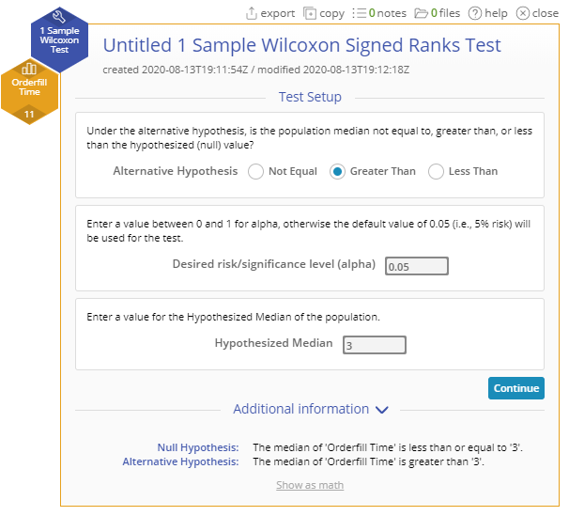
1 Sample Wilcoxon Test Example
nptest_example_datasets.xlsx
You must have raw data to run any non-parametric test. Summary data cannot be used with these tests.
Steps:
Click on the data file in the data sources panel and drag the Orderfill Time variable onto the Data variable drop zone on the study.
Set up the test as shown, and click Continue:
Example:
The data for this example consists of the time to fill out 15 randomly chosen extended warranty forms. We want to test, at the 10% level, whether the median time to fill out the forms exceeds 3 minutes.
Notes:
Alternative Hypothesis: “Greater Than”
Desired risk/significance level (alpha): 0.05
Hypothesized Median: 3

Slide 4
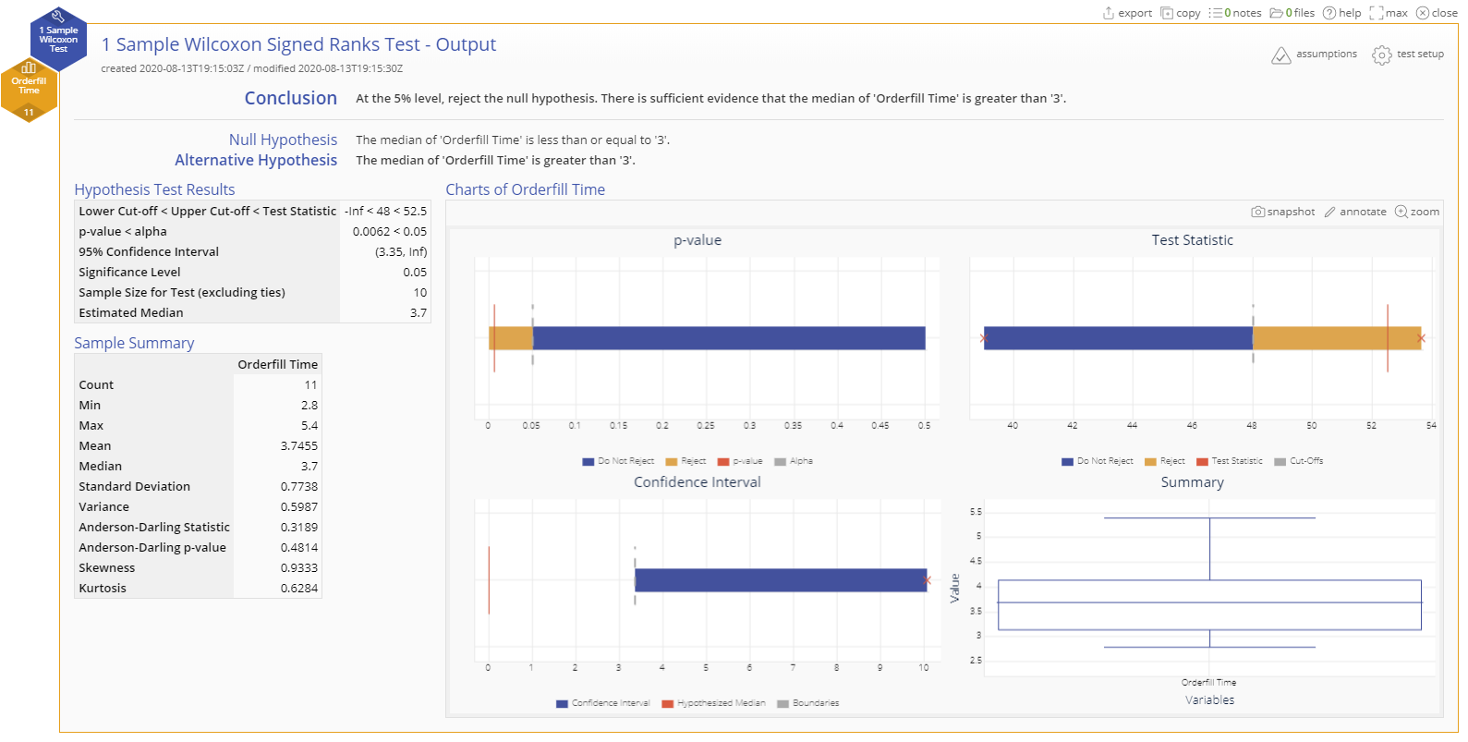
1 Sample Wilcoxon Test Example Output

