Slide 1
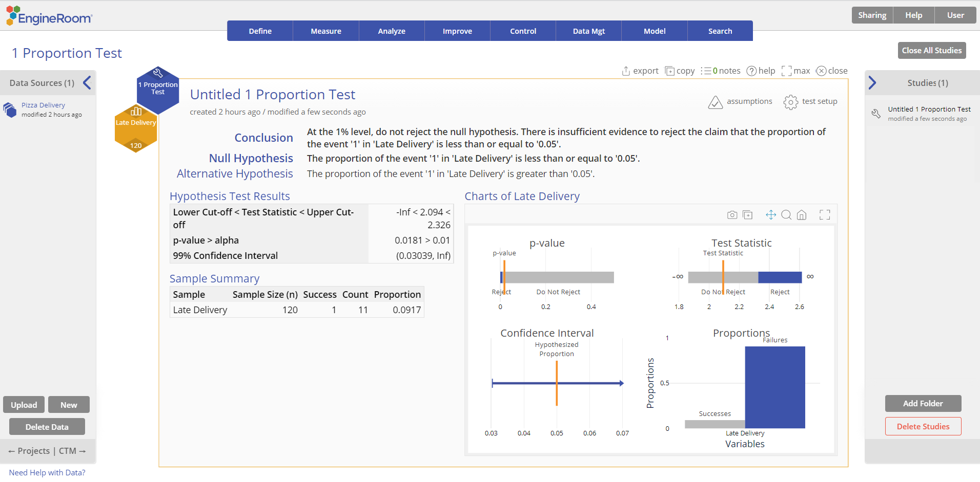
1 Proportion Test
When to use this tool
Use the One Proportion Test to test whether the probability of occurrence of an event is different from, greater or less than, a standard or historical value. This test is based on the binomial distribution with parameters n (number of trials) and p (probability of the event in the population).
The test makes the following assumptions:
The data variable is binary (only two possible outcomes).
The units are randomly sampled.
The probability of the event ‘p’ is the same (constant) for all the units in the population. In other words, each unit in the population has the same probability of being a 'success'. For example: If you tossed a coin 10 times, each toss has the same probability (say 0.5) of coming up Heads.
Tutorial:
https://media.moresteam.com/university/tutorials/nonint/new/oneProportionTest.mp4

Slide 2
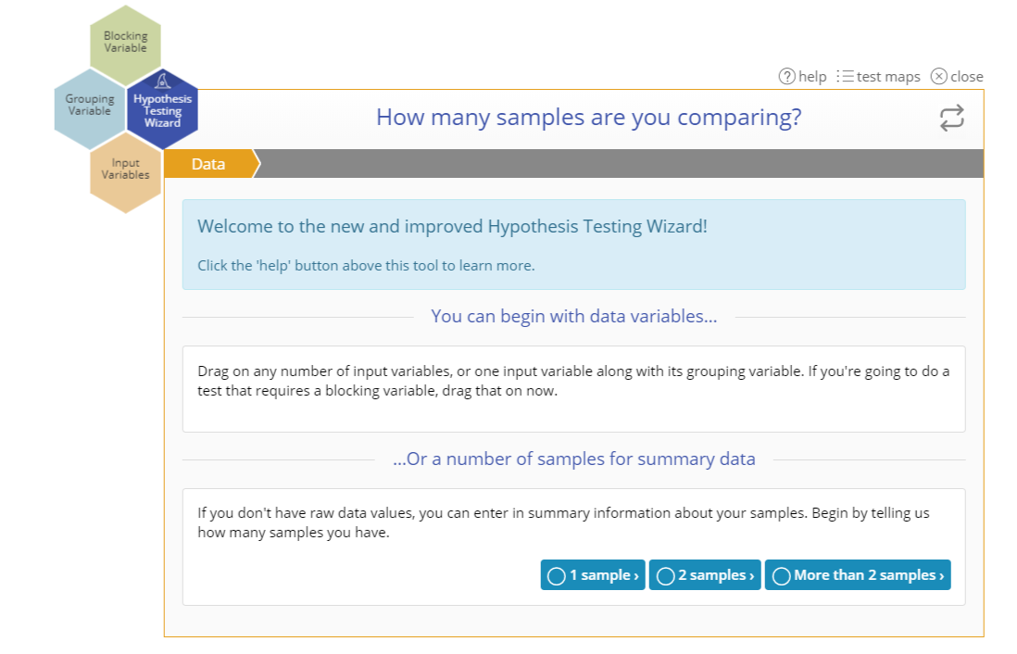
Using EngineRoom
Analyze > Parametric > 1 Proportion Test
You can also use the Wizard:
Analyze > Hypothesis Testing Wizard
Notes:
Note:
If you are not sure which test is best suited to your data or scenario, use the Wizard which will lead you through a series of questions and answers to the appropriate test. Select Analyze > Hypothesis Testing Wizard.

Slide 3
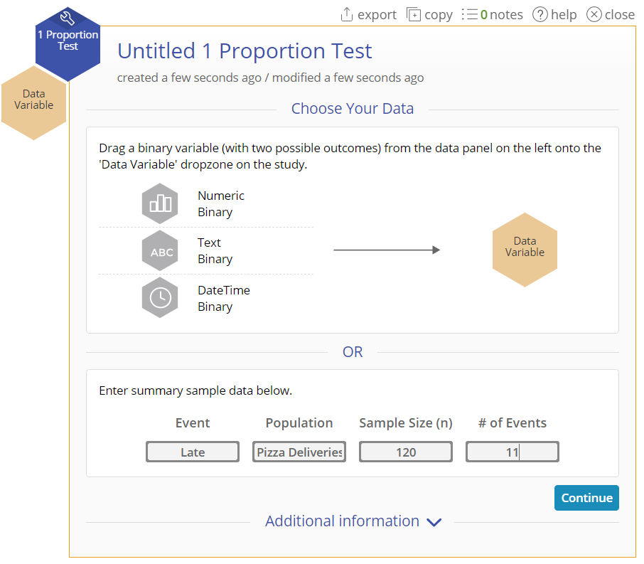
1 Proportion Test (Summary Data) Example
If you have summarized sample data instead of the actual values, you can simply enter the summary data into the test setup dialog. In this case we're testing whether the proportion of late pizza deliveries is greater than 0.05, at the 1% level.
Using the standalone test:
Enter the summary data into the form provided:
Event: “Late”
Population: “Pizza Deliveries”
Sample Size (n): 120
# of Events: 11
Click “Continue”.

Slide 4
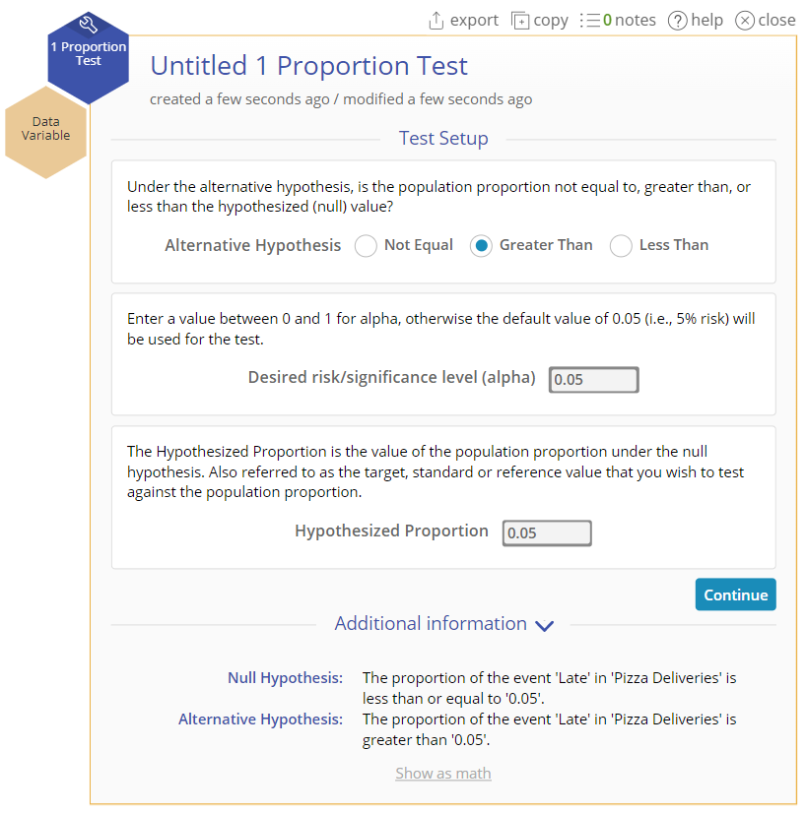
1 Proportion Test (Summary Data) Example
Set up the test as shown:
Alternative Hypothesis: “Greater Than”
Significance Level: 0.01
Hypothesized Proportion: 0.05
Click “Continue”.

Slide 5
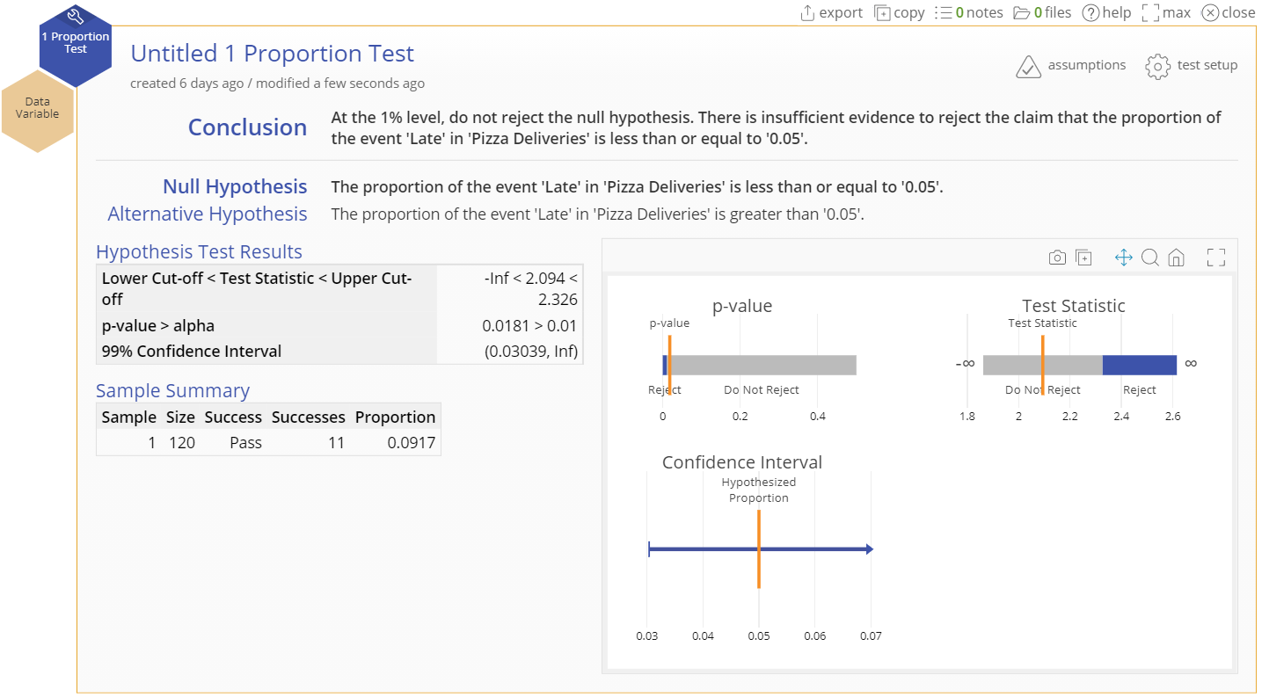
1 Proportion Test (Summary Data) Output

Slide 6
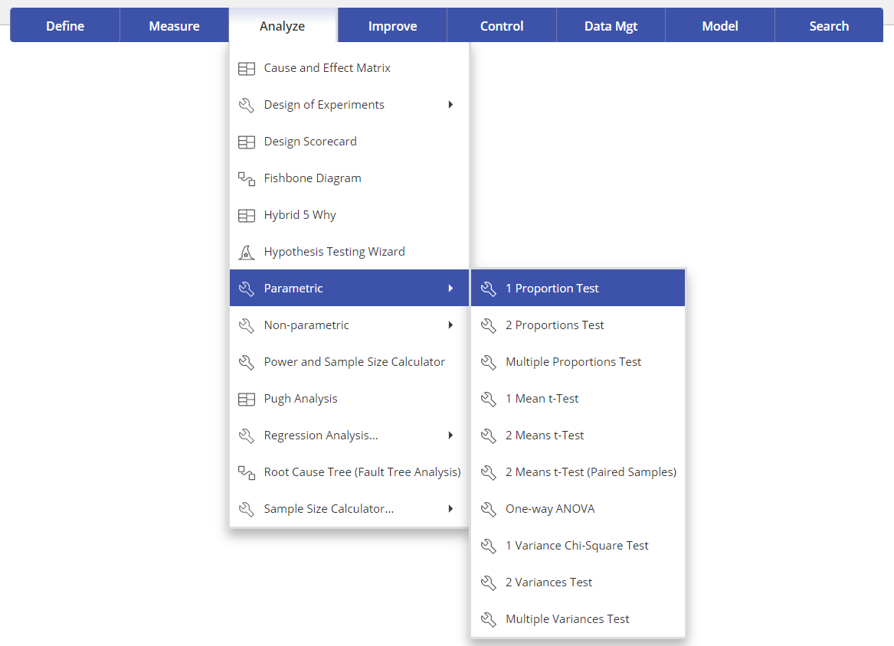
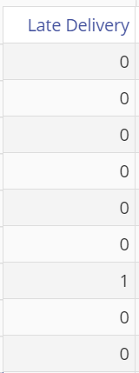
1 Proportion Test (Raw Data) Example
Pizza_Delivery.csv
Using the standalone test:
Most of the time, you will have summary data if you're dealing with proportions (e.g. 23 defectives in a batch of 100) – it is rare to have raw data in the form of 0s and 1s. However, if you have the raw data, follow these steps:
The data set provided contains a binary variable, Late Delivery, containing 120 observations coded 1 for a late delivery of pizza and 0 otherwise. Test whether the proportion (probability) of late deliveries is greater than 0.05, at the 1% level of significance.
Your data should look like this (the data format can be text instead of numeric, but must be binary):

Slide 7
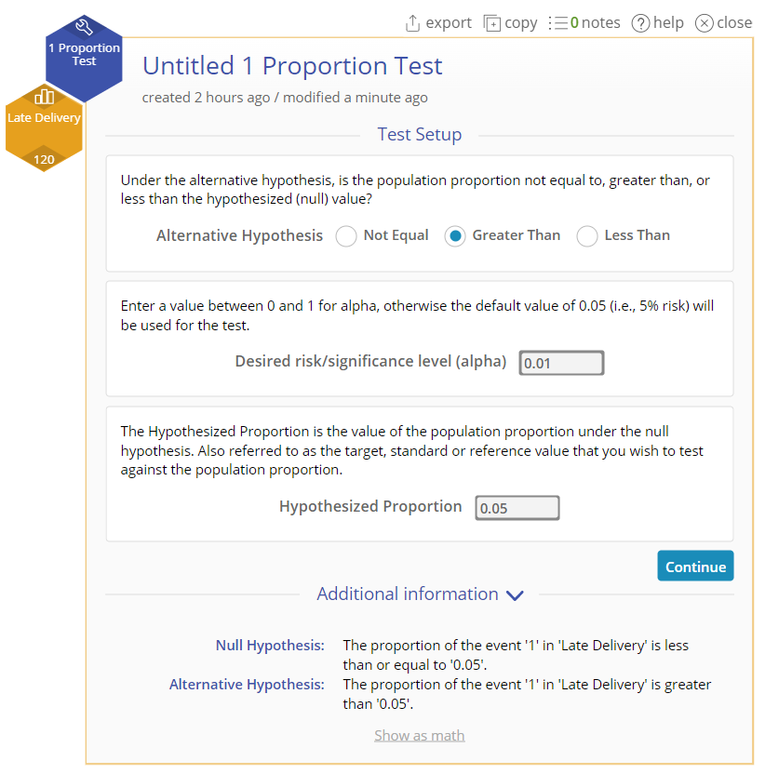
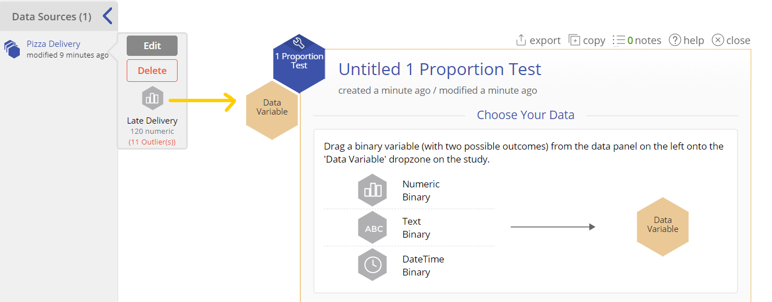
1 Proportion Test (Raw Data) Example
Steps:
Open the test and drag the Late Delivery variable from the data source onto the Data Variable drop zone:
2. Set up the test as shown and click Continue:
Alternative Hypothesis = “Greater Than”
Significance level: = 0.01
Hypothesized Proportion = 0.05

Slide 8
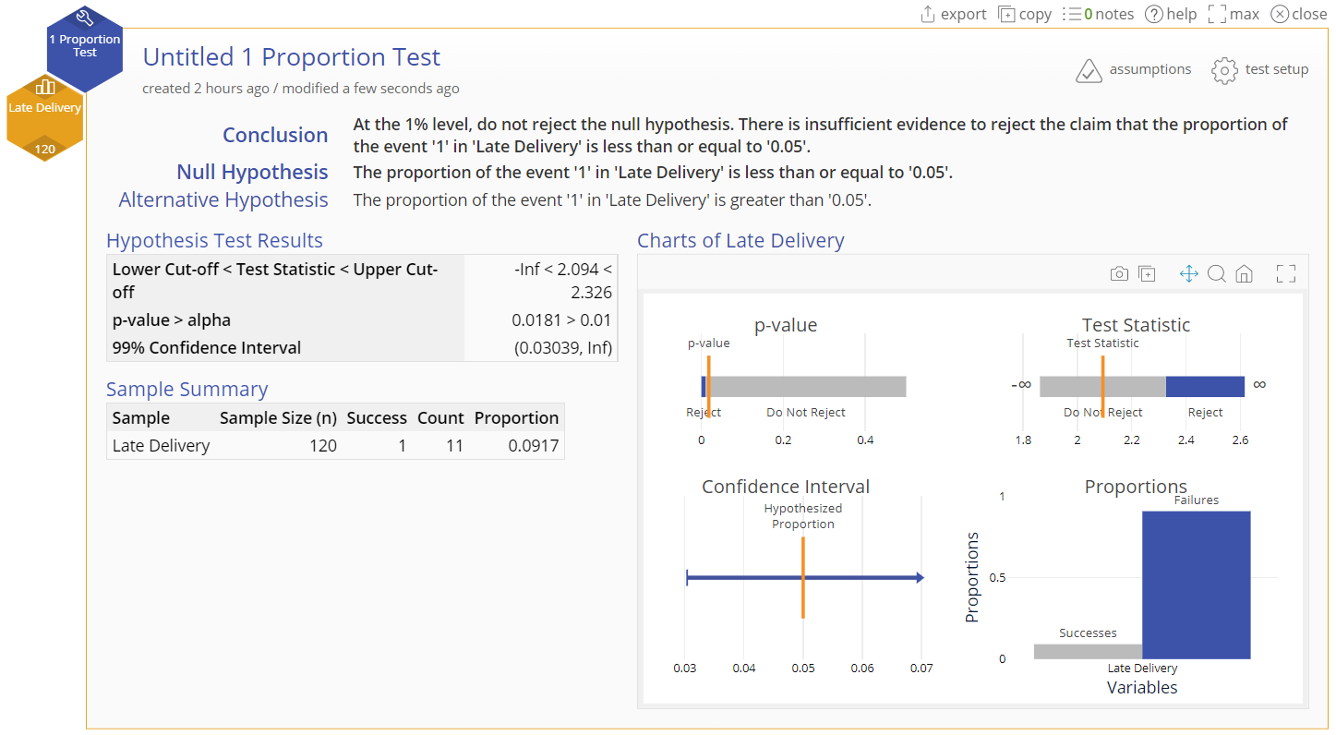
1 Proportion Test (Raw Data) Output

