Slide 1
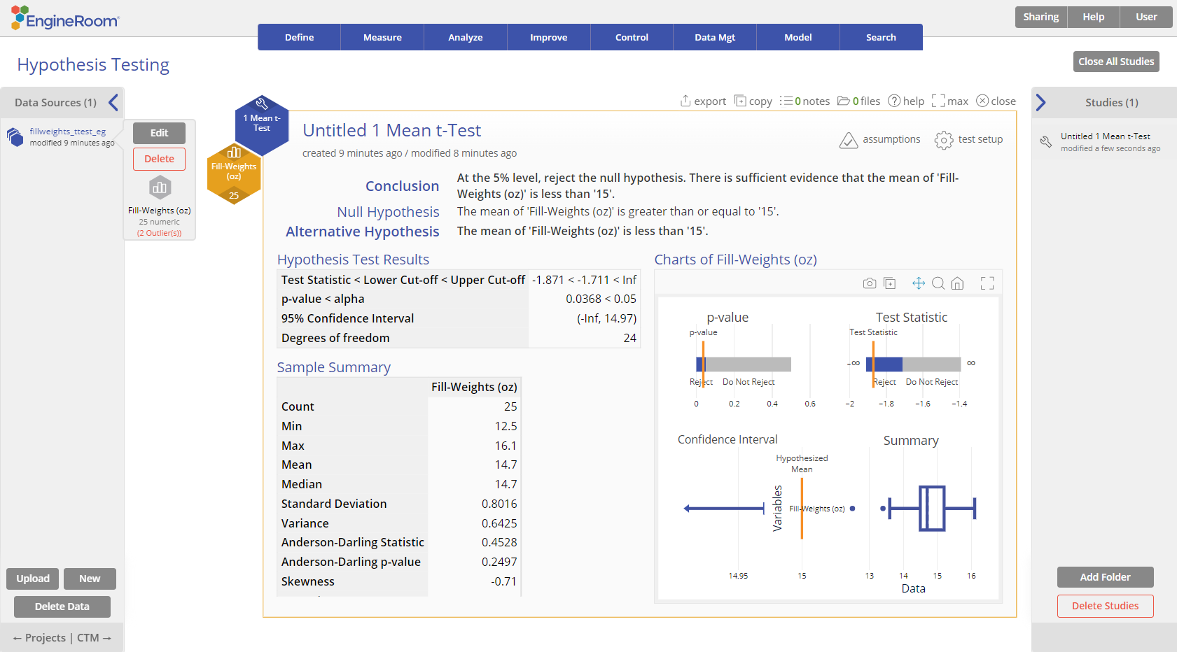
1 Mean t-Test
When to use this tool
Use the 1 Mean t-Test to compare the mean (average) of a continuous process characteristic to a specified value, when the population variance is unknown.
The test makes the following assumptions:
The data are continuous numeric.
The units are randomly sampled.
The data are normally distributed.
This test uses the sample standard deviation to estimate the population standard deviation. It can be used even if your data are not normally distributed, as long as you have a large sample (n > 30).
This test can be used on raw data (i.e., the actual sample measurements) or sample summary data in the form of the sample mean and standard deviation.
Tutorial:
https://media.moresteam.com/university/tutorials/nonint/new/one_mean.mp4

Slide 2
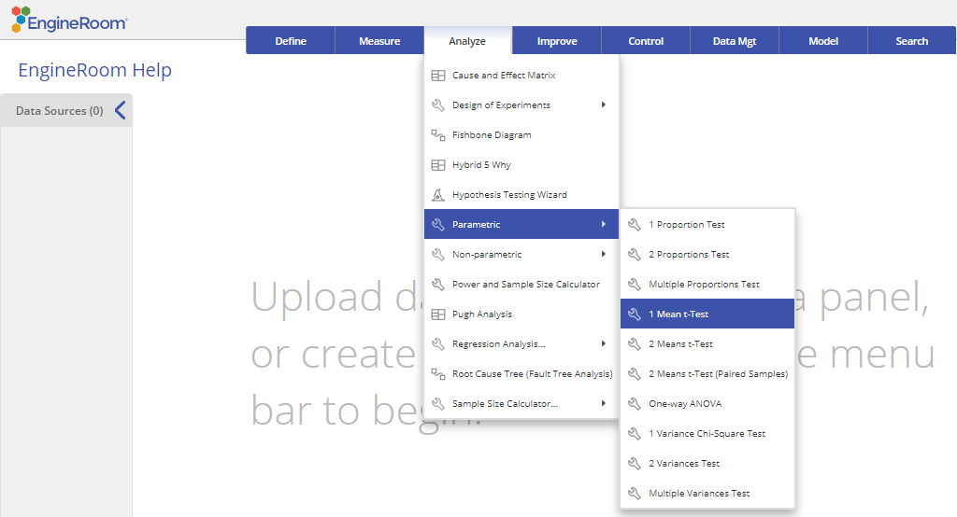
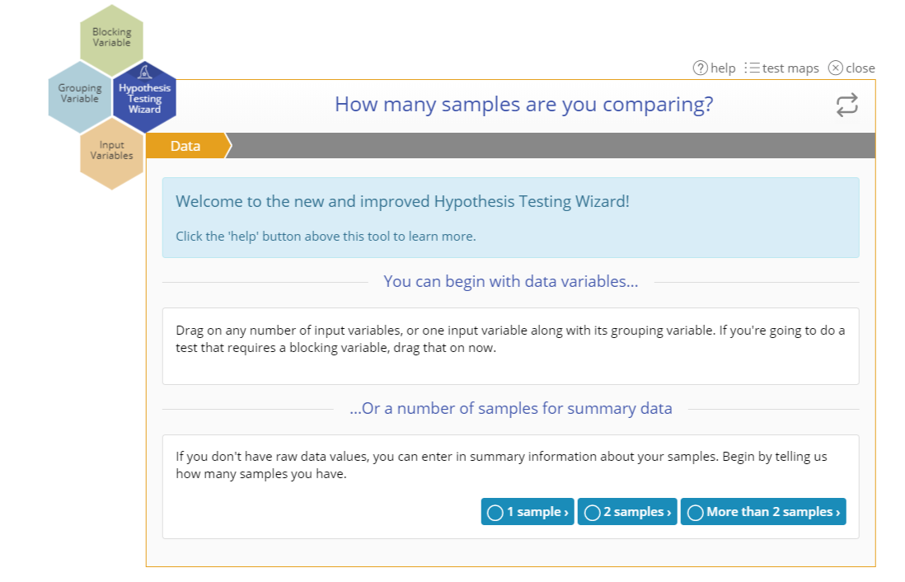
Using EngineRoom
Analyze > Parametric > 1 Mean t-Test
You can also use the Wizard:
Analyze > Hypothesis Testing Wizard

Slide 3
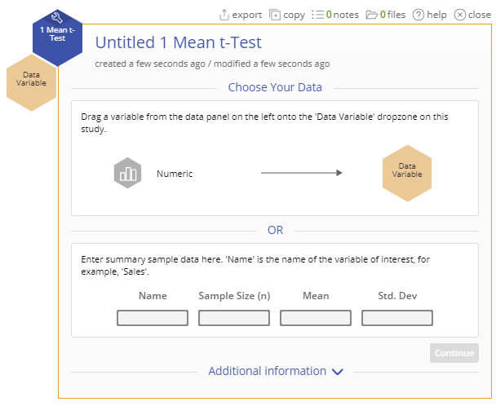
1 Mean t-Test (Raw Data) Example
fillweights_ttest_eg.csv
In our example, a manager at a breakfast cereal company wants to test whether the average fill-weight of cereal boxes is less than the printed weight of 15 ounces, at the 5% level.
For raw data all you need is a single column of measurements:

Slide 4
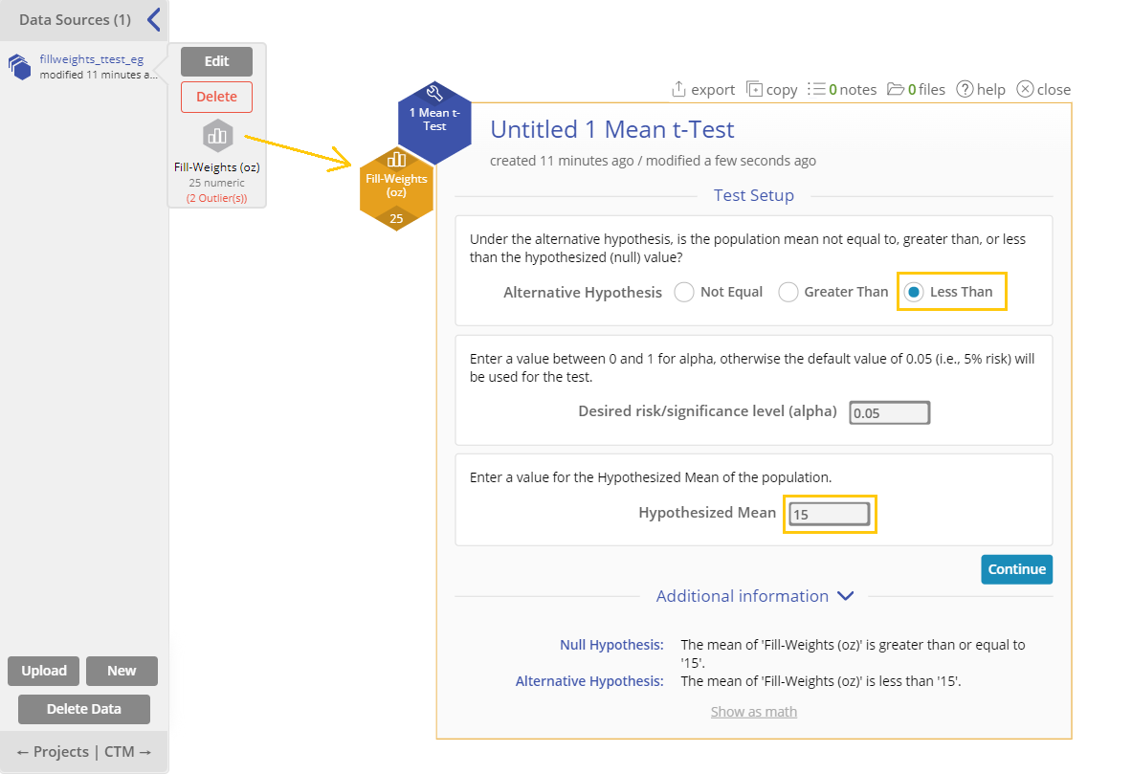
1 Mean t-Test (Raw Data) Example
Steps:
Load the data file into EngineRoom
Click on the data file in the data sources panel and drag the Fill-Weights (oz) variable onto the Data variable drop zone on the study.
Set up the test as shown
Alternative Hypothesis: “Less Than”
Significance level: 0.05
Hypothesized Mean: 15
Click Continue.

Slide 5
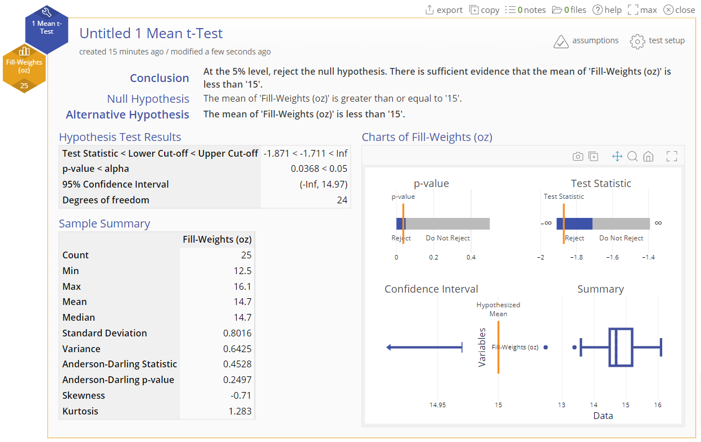
1 Mean t-Test (Raw Data) Output

Slide 6
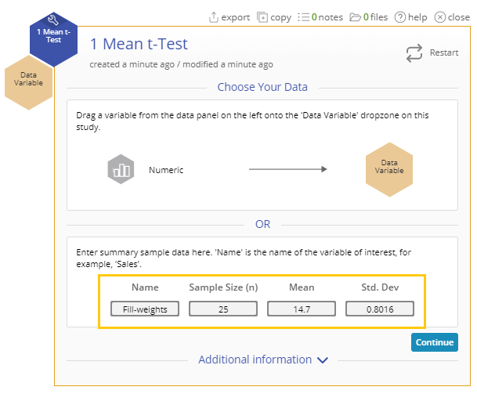
1 Mean t-Test (Summary Data) Example
Now let's run the same test using the summary statistics from the data: Given Sample size = 25 Mean fill-weight = 14.7 ounces Standard deviation = 0.8016 ounces.
Enter the summary data into the form provided:
Name: “Fill-weights”
Sample Size (n): 25
Mean: 14.7
Standard Deviation: 0.8016
Click “Continue”.

Slide 7
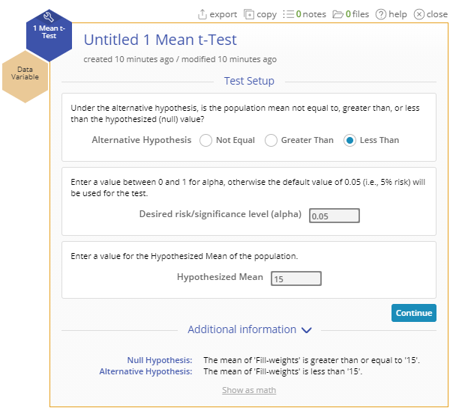
1 Mean t-Test (Summary Data) Example
Set up the test as shown:
Alternative Hypothesis: “Less Than”
Significance Level: 0.05
Hypothesized Proportion: 15
Click “Continue”.

Slide 8
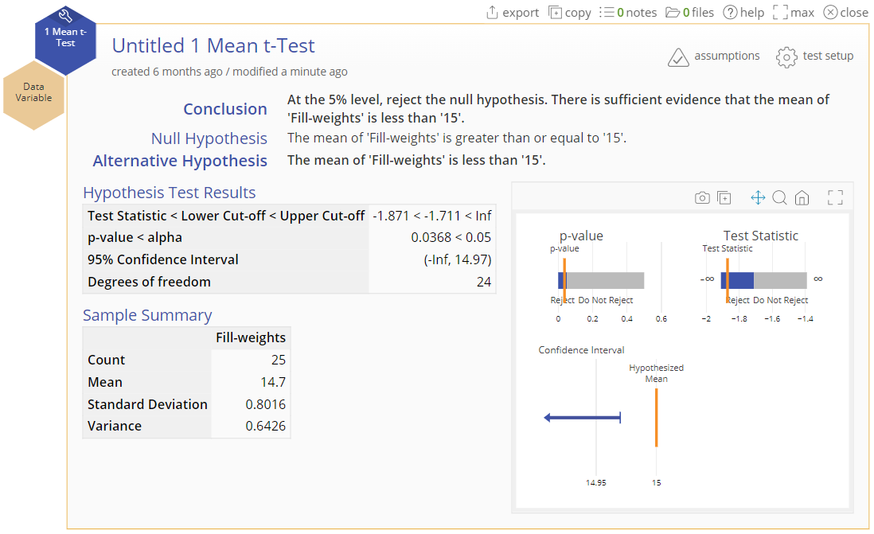
1 Mean t-Test (Summary Data) Output

